Slide 1

The Association of State Public Health Nutritionists (ASPHN)
Member Orientation
Notes:
Amber – Welcome Everyone! We’re so glad you’re here to learn more about the Association of State Public Health Nutritionists or ASPHN. We’re glad to have you here as either a member or someone interested in becoming a member.
My name is Amber Brown. I’m a consultant for the ASPHN. This orientation is being put on by the Membership Communication and Outreach Committee and I help support that Committee.
During this orientation we are going to share a little bit of information with you about the organization, benefits to you as a member and how you can take advantage and get involved. This will be a high level overview and I highly encourage you visit our online orientation module if you haven’t already.
Add link to chat and it was also in the email this morning.
https://asphn.org/courses/asphn-member-orientation/
The majority of the call we’ll split into breakout rooms so that you have a chance to meet other members.
Before we dive in, I’m going have a couple of people introduce themselves. First, Leslie Lewis, who is the current chair of the MC&O Committee.
Now, I’ll let Karen Probert, our executive director introduce herself.
Before we move forward, I want to get a sense of who we have on the call today.
Poll questions.

Slide 2
Table of Contents/ Objectives
Who is ASPHN: Structure and Funding
Benefits/Making the Most of Your Membership
Make the Most of Your Membership
Councils/Committees
Leadership Development
Networking with Other Members
Wrap Up and Questions

Slide 3
What is ASPHN?
More than 950 members
Our Mission:
To improve public health by creating and strengthening equitable nutrition policies, systems, environments, and programs for all people through development of diverse public health nutrition leaders and collective action of members nationwide.
Our Vision:
All people live in thriving and resilient communities supported by sustainable food systems.
Notes:
To begin with, who is ASPHN? Let’s talk about who we are, what we do and how we are structured/funded.
ASPHN is a membership organization. We have grown a lot over the last few years and now have over 850 members from all over the country.
Our members work in a variety of areas of public health nutrition. We have members who work in WIC, Maternal child health, school nutrition, CACFP, Universities, Title V, just to name a few. Members support policies, funding, strategies and programs that promote nutrition and physical activity and prevent disease.
Our Mission:
To improve public health by creating and strengthening equitable nutrition policies, systems, environments, and programs for all people through development of diverse public health nutrition leaders and collective action of members nationwide.
Our Vision:
All people live in thriving and resilient communities supported by sustainable food systems.

Slide 4
What is ASPHN?
Goals:
  Membership Engagement. Maximize membership engagement.
  Professional Development. Strengthen members’ knowledge and skills.
  Collaboration. Cultivate diverse, strategic partnerships to fulfill priorities.
  Policy. Support equitable policy, system, and environmental (PSE) changes.
  Career Development. Advance PHN as a profession at all career stages.
  Internal Operations. Maintain sufficient resources to sustain continued operations.
Notes:
ASPHN has 6 main goals as a part of our strategic plan.
Goals:
Membership Engagement. Maximize membership engagement.
Professional Development. Strengthen members’ knowledge and skills.
Collaboration. Cultivate diverse, strategic partnerships to fulfill priorities.
Policy. Support equitable policy, system, and environmental (PSE) changes.
Career Development. Advance PHN as a profession at all career stages.
Internal Operations. Maintain sufficient resources to sustain continued operations.

Slide 5
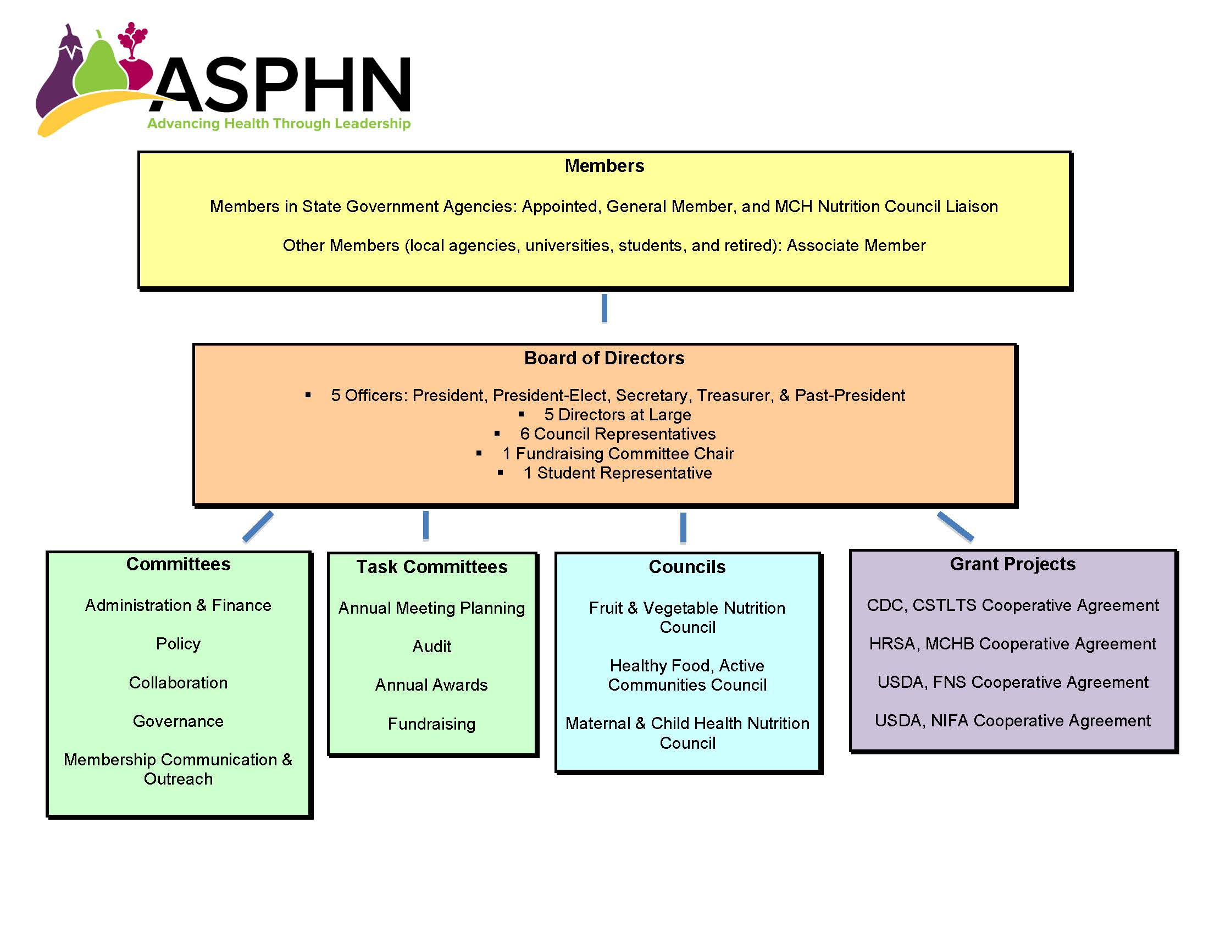
Organization Chart
Notes:
ASPHN is a 501c3 nonprofit virtual organization. ASPHN does not have any employees. Instead there are consultants who work across the country. I’ll share more about that in a moment.
As you see on this organizational chart, we are a membership organization.
The members elect a board of directors who are responsible to the membership.
Under the board there are various councils and committees and grant projects who are responsible to the board.

Slide 6
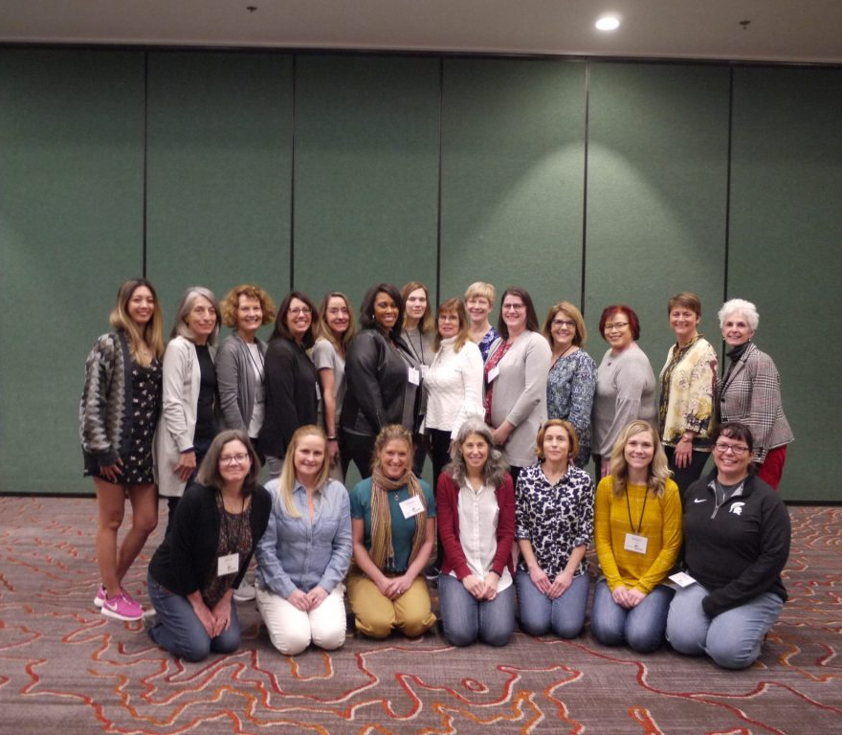
Board of Directors
5 Officers
  President, President-Elect, Past President, Secretary, Treasurer
5 Directors at Large
6 Council Representatives
1 Fundraising Committee Chair
1 Student Representative
See current board members here.
Notes:
We are a virtual organization with board representation from all over the country.
Board meets together every month on the 2nd Friday of the month… Any one is welcome to join these meetings.

Slide 7

Consultants
Virtual Model
Consultants support the Committee, Council and project work of the Association.
Currently 20+ Consultants
  https://asphn.org/contact-asphn/
Notes:
Like I mentioned earlier, ASPHN does not have employees, ASPHN operates using a virtual structure and has been successfully using this model for over 20 years. ASPHN fulfills grant deliverables by negotiating contracts with individuals, small businesses, nonprofit organizations, and/or universities to do the work. The consultants support the committee, council, and project work of the association.
You can find information about the consultants on our "Contact ASPHN" webpage
https://asphn.org/contact-asphn/

Slide 8

Types of ASPHN Membership
Appointed Member
  Appointed by the State Health Official; employee of the public health dept
General Member
  State level public health nutritionist
Associate Member
  Those who don’t fall under General Member
  Student/Emerging Professional
  Retired Member
Notes:
Just a quick note about membership categories. There are 3 categories of membership. If you answered unsure to the poll question earlier, this may help you know which type you are:
Appointed Members are Appointed by the state health official and must be an employee of the public health dept
General Members are individuals who perform state-level public health nutrition duties in the state department of health, human services, education, agriculture or aging, or tribes. These members can be nominated by the appointed member or they can self nominate
Associate Members are individuals or agencies/organizations with an interest in public health nutrition who do not fall under the General Member category. This category also includes emerging professionals, students and those who are in the first two years following graduation as well as retired members. (They have a reduced yearly fee)
https://asphn.org/become-a-member/

Slide 9
Funding Partners
CDC:
  Division of Nutrition, Physical Activity and Obesity (DNPAO)
  Division for Heart Disease and Stroke Prevention
  Division of Defects and Developmental Disability (NCBDDD)
HRSA, Maternal and Child Health Bureau (MCHB)
USDA, FNS; Farm to CACFP: Win for Farmers, Students, and Educators (FARMWISE)
Notes:
I do want to briefly acknowledge where ASPHN gets the funding to do what we do. ASPHN is primarily funded by federal funds. We receive funding from CDC, HRSA (MCHB) and USDA. Our funding partners make the work we do possible.
That is just a little about the organization and how it works.
For more detailed info on the consultants, the board, or how the organization is set up, or funding please visit the online module or the about tab on the website.

Slide 10
Benefits of ASPHN Membership
Webinars/Networking Calls & Free CEU’s
Connect with other members
Resources
Monthly e-Newsletter
Kept abreast of public health nutrition hot topics with the Development Digest
Annual Meeting

Slide 11

Stay Up to Date with the Latest ASPHN News
Monthly Newsletter
Social Media Channels (Instagram, LinkedIn, Facebook, Twitter)
ASPHN.org home page
  Monthly Themes
  New Products
  Sign-ups
  Member Spotlights
Notes:
I want to shift gears a little. This is the information that will be most useful to you as a member and knowing how to get the most from your membership.
I’m going to share with you some of the primary ways that we communicate with you as a member and then give a brief overview and highlights of our website.
The primary way we communicate is through our monthly newsletter. This is typically sent via email on the 2nd Monday of each month and it gets delivered straight to your inbox. It’s a member favorite. Our newsletter editor Janelle Clepper does a great job at condensing the info and making it easy to read and understand, giving you a lot of actionable items where you can go and engage with us. I encourage you to be on the lookout for the newsletter. Let us know if you’re not getting it. If you happen to delete it, we post all issues to the website and I’ll show you how you can access those in a minute.
Another way we communicate with you is through social media. We are currently more active than we’ve ever been on social media. We have channels on linkedIN, fb, twitter, and Instagram.
(Show Instagram feed)
We try to post a few times a week with info about upcoming events, opportunities, and resources. We really try to highlight our members work as much as possible. We do that through a member spotlight that’s featured on social and the webpage. We try to show the incredible work and strength of the field of public health nutrition and really be an advocate for this profession. So please go check us out and I encourage you to follow us.
Show ASPHN homepage
Finally, we communicate on our homepage. ASPHN.org. This is updated at least monthly.
The first thing you’ll see are the rotators that provide updated info on what is happening. As you scroll there are quick links to events going on right now, new and relevant resources, newsletters, etc.
Next, you’ll see a link to past newsletters, upcoming webinars, and right now the Annual Meeting.
Scorll down and you see 6 portals where you can get a quick feel for what is happening at ASPHN. The first one we try to celebrate something that deals with health or public health. This month is Mental Health Awareness Month, National Women’s Health Week and Eat More Fruits and Vegetables Day. We give links to more info.
Next is the member spotlight, which is currently featuring a student member!
There is a box that shares tools to enhance your practice, ways to get active, a box to show you the impact that we are having and that you are having out in the field as well. We also have something called the sign-up corner which gives you info about upcoming events and how to sign up.
This home page is the page on asphn.org that I would encourage you to look at frequently. It is the most up to date and shares the most relevant information.
I’m going to share a few more areas of the website that you may be interested in.
Welcome Buddy Program –
We offer a welcome buddy program, where we pair a new member with a more experienced member who can share more about the association and how to get involved. We encourage any new member to request a Buddy. You can email amberbrown@asphn.org to request one.
Membership tab – The membership directory is one of our more popular webpages. This is a list of all members. There is a search bar and quick links to help you find members. Once you find someone you’re looking for you can click on their name and it gives you more information. We do not publish your email address for privacy reasons. If you do need an email address contact us and we can provide it.
Next I’d like to look at Resources.
The first tab is Trainings, webinars, and meetings.
This page includes all the recordings of previous webinars and trainings. You can do a search or click into a group. It starts with the most recent. Click it and you will see the recording and slides if available.
Under resources we also have publications. It works in a similar fashion and goes from most recent backward. Here’s the newsletter category to find past issues.
Next the professional development blog. In here is our development digest. These are articles written by us for our membership. These articles deal with various aspects of professional development. You can scroll to see the articles and then click on them to read more. We try to provide Inspiration, tips and tricks to make you a stronger leader, etc.
Industry jobs openings page. These aren’t jobs available within ASPHN, but rather jobs submitted by members or states where there are openings within their departments. If you have something you’d like us to post, let us know.
Impact tab,
Shares links to specific programs and grant projects. I’ll share more about these in a moment.
Events,
The Annual Meeting is the flagship event. Happening in a couple of weeks. There are more details there. You can access previous AM information.
Upcoming events shares all of the upcoming webinars, meetings, traininings coming up with details and registration information.
Councils and Committees – I will share more details about Councils/Committees in a minute

Slide 12
Benefits of ASPHN Membership
Webinars/Networking Calls & Free CEU’s
Connect with other members
Resources
Monthly e-Newsletter
Kept abreast of public health nutrition hot topics with the Development Digest
Annual Meeting (Virtual in 2021)

Slide 13
Add Benefits pages

Slide 14
Making the Most of My Membership and
Getting Involved
Councils
Committees
Work Groups
Notes:
Okay, we’ll pause to see if anyone has any questions.
I’ve shared more about the association and ways we communicate with you.
I want to share how you can involved in the association. We have a number of ways that you can be involved within the organization and provide opportunities for you to lead and learn in your passion areas. One way is through getting involved with committee and council work.
ASPHN Council’s, Committee’s, and work groups are open for ASPHN members to join and are a great way to provide input and feedback to ASPHN and network with others doing similar work.

Slide 15

Councils
National Fruit & Vegetable Nutrition Council
Healthy Food, Active Communities Council
Maternal & Child Health Nutrition Council
Notes:
ASPHN has 3 councils that are open to all members.
The purpose of the Council is to meet the needs of our members, similar to a member interest group. Many on this call are already a member of a Council.
The association holds a monthly webinar. Each month is sponsored by one of the Councils.
FV Nutrition Council (311 member)
The FV Council helps shape legislation and make a difference in the public’s access, purchase and consumption of fruits and vegetables.
Beyond sponsoring webinars, the Council provides Networking calls, a CACFP work group, and a WIC Work group as well as a Leadership Team
Healthy Food, Active Communities Council (328 member)
HFAC members work to strengthen policy, environmental change, programs, services and evidence-based practices to promote healthy food and active communities through the development of public health nutrition leaders and collective action of members nationwide.
They hold regular All Member council meetings and webinars
MCH Nutrition Council: (407 members)
MCH Council members work on a range of policies, programs and services including the promotion of nutritional well-being across the lifespan.
Participation on the Council helps members develop their leadership skills, engage in advocacy and public policy development, and share ideas with peers.
They have a Steering committee and webinars.
Find more info on the Councils under the Councils tab.

Slide 16

Committees
Policy (open to all members)
Collaboration (open to all members)
Membership Communication & Outreach (open to all members)
Governance
Short Term Committees (Annual Meeting Planning Committee)
Notes:
ASPHN has 3 committees that are open to all ASPHN members (Policy, Collaboration, Membership) as well as 1 committee that consists of ASPHN leadership (Governance) and periodically have short term committees like the Annual Meeting Planning Committee. The purpose of ASPHN's committees is to help move forward ASPHN’s strategic plan and goals.
Policy Committee – open to all; ASPHN’s voice in promoting and influencing public health nutrition policies
Collaboration Committee – open to all; Works to strengthen and improve ASPHN’s strategic partnerships with other organizations
MC&O – open to all; provide guidance regarding communications to ASPHN membership and its partners
Governance Committee – consists of elected members (including past president, director at large who chairs the committee, and past chairs of each ASPHN council); recruits nominees for positions on the board of directors
We periodically have short term committees as well, such as an Annual Meeting planning committee
If any of those areas pique your interest, check out the website under the Committees tab to find contact info for each Committee.
There are lots of ways that students can also get involved in Council’s and Committee’s. We love working with our student members!

Slide 17

Work Groups
CACFP Work Group
WIC Work Group
Student Engagement Work Group
Annual Awards Selection Committee
Student Board Representative Selection Committee
Notes:
Within the organization we also have many work groups that you may be interested in. We have a few standing work groups and periodically short-term work groups pop up as well. These can be great ways to get involved for just a short time.
Make sure to watch the newsletter for upcoming opportunities. Most of the work groups are open to all members and many of them fall under a Committee or Council.
The ones listed here are standing work groups.
The current work groups are:
CACFP work group which is currently working on increasing cultural recipes within the CACFP program.
WIC Work Group meets quarterly. Their next meeting is in August.
MCH Diversity, Equity, and Inclusion Work Group
Thoughtful Advisors for ASPHN’s Work to Prioritize Equity, Inclusion, and Disparities Work Group
If you’re interested in joining any of these work groups you can type in the chat box or you can email me at amberbrown@asphn.org

Slide 18




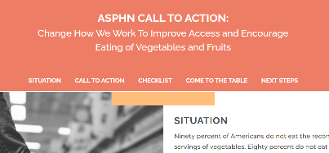
ASPHN Products and Grant Projects
Notes:
Thank you! We are going to pause and see if anyone has any questions or comments about Councils/Committees.
ASPHN has many resources and products for our members. We want you to be aware of a few of those resources. And then we’ll share some of the work that ASPHN’s consultants are working on.
These items are all found under the Resources or Impact tab of the website.

Slide 19

https://www.seeitsayitshareit.org/
Notes:
The first product we’ll talk about is ASPHN's SEE IT. SAY IT. SHARE IT. Campaign, which is a campaign to promote the value of public health nutrition and to improve visibility of the profession. It’s available at seeitsayitshareit.org
The website includes:
Catchy soundbites, posters, videos that our members can use to communicate the most vital aspects of their work: advocacy, collaboration, education, strategy, and creating access to better nutrition and active living. “Nutrition is a right, not a privledge.” You will see these scattered and used throughout our website and products.
Also on the website is a Public Health Nutrition Hall of Fame, which highlights the work of ASPHN members in public health nutrition. You can view this amazing work there. There is also a link to nominate yourself or colleague.
https://www.seeitsayitshareit.org/
.

Slide 20
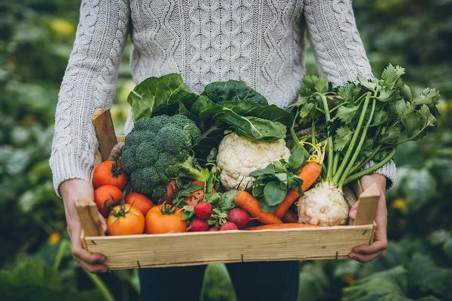
Vegetable & Fruit Call to Action
Call to Action
Checklist for Change
Come to the Table
Next Steps
https://asphn.org/call-to-action-vegetable-and-fruit-consumption/#cta
Notes:
ASPHN developed and sent a Vegetable & Fruit Call to Action to their members and partners. This call to action was a way for ASPHN to respond to the public health crisis of declining fruit and vegetable consumption. We had such a big response to this call to action that ASPHN developed a webpage devoted to it. The webpage includes the call to action, a checklist for change, info on how to come to the table and next steps. Be sure to visit this webpage in order to learn more and join the call to action.
https://asphn.org/call-to-action-vegetable-and-fruit-consumption/#cta

Slide 21

Food & Nutrition Security Primer
Food and Nutrition Security Terms
Background on why terminology matters
Table of terms and definitions.
Updated frequently
https://asphn.org/food-and-nutrition-security-primer/
Notes:
This resource shares background information on food and nutrition security terms with an emphasis on why terminology matters. There is a continuously updated table with terms and definitions(opens in a new tab) used by national food, nutrition, and health programs and organizations.
This resource is comprised of four web pages, Introduction, Deeper Dive, Terms & Definitions, and Federal Program Use. Within this resource, you'll learn more context and information on terms, definitions, and/or descriptions and understand that words have power and that word choice matters to our work. You can also gain insight into why different agencies use certain terms.
https://asphn.org/food-and-nutrition-security-primer/

Slide 22

Infant Transition Feeding Briefs
Complimentary feeding briefs based on the DGA’s to assist nutrition professionals in supporting families’ cultural preferences
East African, Ukrainian, and Native American Families
Coming soon: Afghan Families
https://asphn.org/transition-feeding-brief/
Notes:
ASPHN has developed some infant transition feeding briefs.
For the first time, the Dietary Guidelines included dietary recommendations for infants and toddlers. ASPHN developed these complementary feeding briefs to assist nutrition professionals in supporting families’ cultural preferences.
Currently, the following briefs are available:
East African
Ukrainian
Native American
Coming soon: Afghan
https://asphn.org/transition-feeding-brief/

Slide 23

Categories of Practice Website
(PublicHealthNutrition.org)
Categories of Practice Website
Notes:
The Categories of Practice Website found at publichealthnutrition.org is another website that ASPHN manages. It’s designed specifically for public health nutritionists to increase knowledge and skills. The website was developed in collaboration with the Academy of Nutrition and Dietetics Public Health Community Nutrition practice group and the association of graduate public health nutrition programs
It’s dedicated exclusively to the categories of practice within public health nutrition. Within each category there are specific indicators to show yourself and others that you’ve mastered that category of practice in public health nutrition. Within each category there are resources to help you achieve that indicator and ultimately category of practice.
publichealthnutrition.org

Slide 24
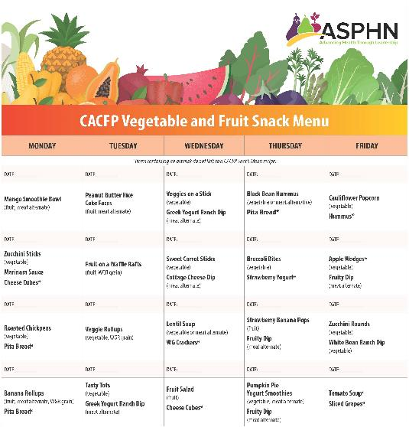
Child & Adult Care Food Program (CACFP) Vegetable & Fruit Snack Menu
View the snack menu here.
Notes:
Within the FV Council there is a CACFP work group. They worked very hard to create a CACFP Vegetable and Fruit Snack Menu to help providers more easily plan, prepare and provide healthier snack options for children. This is a 4 week cycle menu. There is a webpage devoted to it where you can view or download the full menu or individual recipes and be sure to share your feedback at the bottom of the page.
They are currently working on adding more cultural recipes to this snack menu along with tips for creating cultural recipes. These should be available very soon. Watch your inbox for an announcement.
The next project they are working on is developing newsletter templates for Farm to CACFP.
https://asphn.org/cacfp-veggie-and-fruit-snack-menu/

Slide 25

Student Opportunities at ASPHN
Fellowship Program for Public Health Practice
Student Board Representative
Annual Student Networking Session
Involvement in Councils/Committees
Student Webpage
Notes:
I also want to just briefly mention that there are a lot of ways that students can get involved in the association as well! We love our students!
ASPHN provides a traineeship and a fellowship.
The Health Equity Fellowship Program was created to support the diversification of the public health and health-related workforce. Since 2002, the fellowship program has prepared over 1,000 students with practical skills in the Essentials of Public Health Services and Core Competencies of Health Education and Promotion.
It’s a 12 week fellowship where students complete health equity projects in public health with federal, regional, state and local health agencies.
DNPAO Nutrition & Physical Activity Traineeship –
The DNPAO Nutrition and Physical Activity Traineeship was designed by ASPHN to create an interest in a career in public health nutrition and physical activity in university students from an underrepresented population (race or ethnicity). The eight-week, competency-based training teaches skills needed for entry-level public health professionals. Experiential learning is provided through state health departments and similar facilities. A fellowship grant is awarded to the chosen students during the eight weeks.
We also have a student representative on the board. Students can apply for this position each year.
We love for students to get involved in periodic student networking sessions, councils/committees/work groups.
In the chat, I’m going to put a link to a flyer that shares more information about how to get involved as a student.
https://asphn.org/wp-content/uploads/2023/09/flyer-students-v1.pdf

Slide 26

Grant Projects within ASPHN
WIC Fellowship
Fellowship for Public Health Practice
FARMWISE: Farm to CACFP
Children’s Healthy Weight State Capacity Building Program
Developmental Monitoring for WIC Project
State Support & DNPAO Ambassador Calls
Partnership Training Webinars
Notes:
Those are just a few of the resources available to you. There are even more on the website.
ASPHN also has a number of grant projects that are being worked on right now. Some of you may be involved in some of these projects. I want to share a little bit about each of these so that you are aware of the amazing work that our consultants are doing.
I’m barely going to scratch the surface on these, please visit the Impact tab on the website or the orientation module for more information.
I’ve already mentioned the traineeship and fellowship
FARMWISE: Farm to CACFP –
ASPHN, in cooperation with USDA, will administer a Farm to CACFP (Child and Adult Care Food Program) Institute and Learning Collaborative (F2CACFP Institute). This will help states expand Farm to CACFP at preschools participating in this child nutrition program. Farm to CACFP sites will increase local food purchasing, teaching children about food and agriculture, and hands-on learning through gardening. Ultimately, Farm to CACFP will improve young children’s access to healthy food and forge lifelong healthy eating habits.
The Children’s Healthy Weight State Capacity Building Program -
The purpose of the Children’s Healthy Weight State Capacity Building Program is to strengthen state Title V programs’ knowledge, skills and tools in order to successfully integrate public health nutrition. The program focuses on increasing maternal and child health (MCH) nutrition competency and optimizing MCH nutrition-related data sources. ASPHN is working with three states — North Dakota, Oregon and Wisconsin — to develop models of integrating nutrition within their Title V programs with the hope that the models can be replicated within other states.
WIC Developmental Monitoring Project-
Since 2018, The WIC Developmental Monitoring Project has been helping state WIC programs to help them implement developmental monitoring in their WIC clinics using CDC’s "Learn the Signs. Act Early." Program.
We are currently working with 4 Intensive states to provide funding for this effort as well 21 additional states who are a part of the learning collaborative. We provide monthly online trainings, networking calls, newsletters, etc for states who are interested in DM in their state.
ASPHN State Support Networking Calls
ASPHN holds states support networking calls 3-4 times per year for states that have had a decrease in funding related to nutrition and physical activity within the last few years. These calls are designed to help a state to continue this work. They have focused topics for each call and offer a platform for these states to discuss some of the issues/ostables, how they’ve overcome them, how they can continue the work, etc. All call topics and discussion are driven by the participants and resources and guidance are given through peer-to-peer engagement and ASPHN staff. Anyone can join these.
DNPAO Ambassador Calls
The CDC/DNPAO Ambassador Program provides states, which are not currently funded by DNPAO, with a way to directly benefit from DNPAO technical assistance and resources available to the funded recipients. This TA was initiated after ASPHN's State Support calls and thus, ASPHN was invited to attend and provide direction to the Ambassadors Calls, which informs the Ambassador Program given to states.
ASPHN’s Partnership Development & Training Series
ASPHN's Collaboration Committee works with members and ASPHN partners to host informational webinars about the work that ASPHN is doing while also providing technical assistance on tools to strengthen partner relationships.
These webinars also include ASPHN's Liaison Corps which provides valuable insights into the work done with and through ASPHN's partners and projects.

Slide 27
Insert page for each project???

Slide 28

Annual Meeting
June 8-10, 2025; SLC, UT
Theme: Leveraging AI in Public Health Outreach
Poster Sessions
Professional Development Opportunities; Student Sessions
Save the Date:
  June 14-16, 2026
  June 13-15, 2027
https://asphn.org/2025-annual-meeting/
Notes:
ASPHN holds a meeting annually. These are typically in person meetings held in different locations each year.
The 2025 meeting will take place in just a couple of weeks, June 8-10 in SLC, UT
Theme: Leveraging AI in Public Health Outreach
Registration is closed, however, if you would still like to attend in person, please contact Cyndi@asphn.org.
These meetings provide an excellent space for networking with colleagues, poster sessions, professional development opportunities, and updates from our federal partners.
Upcoming dates can be found on our website.
https://asphn.org/2025-annual-meeting/

Slide 29

Questions and Networking
“ASPHN offers a safe and welcoming environment to not only connect with other state public health nutrition professionals and learn from their success or challenges, but to develop your professional skills in leadership, public speaking, and communication.” – ASPHN Member
Notes:
Amber
Thank you for staying with us through this orientation. We are so happy to have you as a member of ASPHN and hope that you will benefit from your membership.
I wanted to share this quick quote from one of our members to close with. “ASPHN offers a safe and welcoming environment to not only connect with other state public health nutrition professionals and learn from their success or challenges, but to develop your professional skills in leadership, public speaking, and communication.” –
We would love to take any questions or comments. Type them in the chat box or unmute yourself.
Go into networking for about 10-15 minutes. Please share who you are, what state you are from, and what area you work in. You are welcome to stay to get to know a few of your colleagues or leave.
You’ll receive an email shortly with a link to a survey for this presentation. We’d appreciate you taking the time to fill that our and provide feedback so we can make these better.

