Slide 1

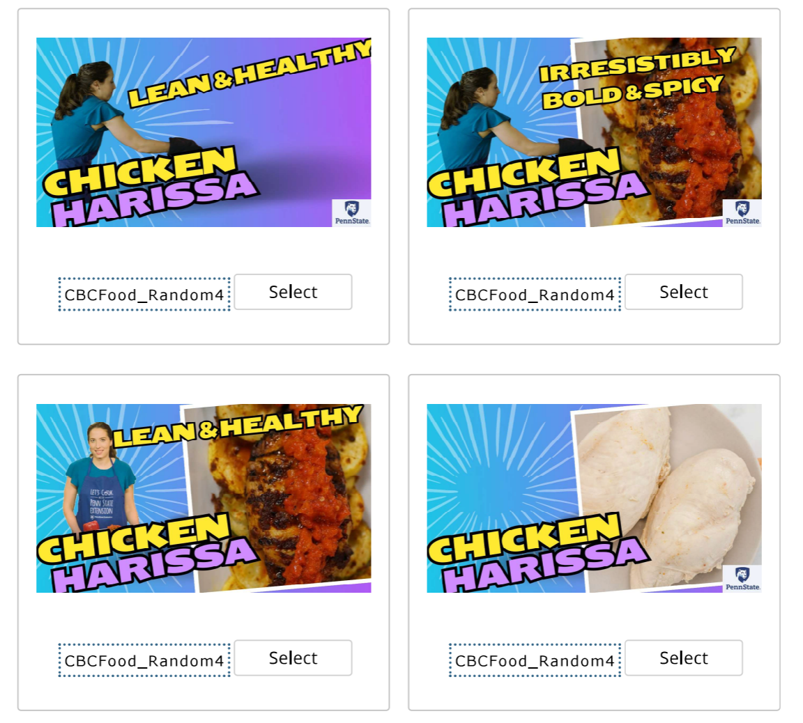
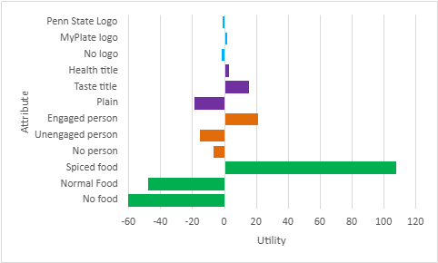
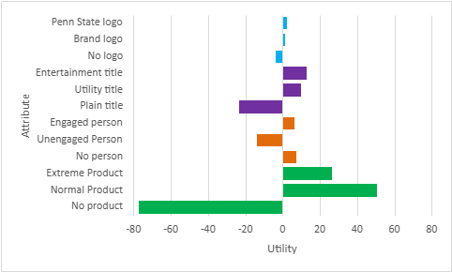
Food presentation drives engagement with social media thumbnails
Callie J. Millward, Frank E. Dardis, Helene Hopfer, Olivia Lawler, Travis Masterson
Department of Nutritional Sciences, Pennsylvania State University, State College, Pennsylvania, United States of America
Background
Methods
  Marketing techniques are used to increase purchase and consumption of energy-dense, nutrient-poor foods
  Adolescents are specifically targeted by food marketing on digital media platforms
  Video content is a prevalent form of digital media across platforms such as YouTube and TikTok
  Many factors influence engagement with video content, including video thumbnails
  Adolescents (n=1001) aged 13–17 years were recruited using a market research platform
  Participants viewed both food and non-food video thumbnails in a randomized order
  Presented with every combination of attributes and asked to select 1 of any given 4 possibilities
  Analysis – Conjoint analysis was done using Sawtooth software as well as frequency tables and descriptive statistics
Results
Discussion
  These findings provide insight into how video thumbnail features may be used to improve future engagement for health-related video content in digital media
  ONE MORE FINDING HERE MAYBE FUTURE DIRECTIONS?
Funding: this research was partially funded by a gift from the McCormick Science Institute

