Slide 1



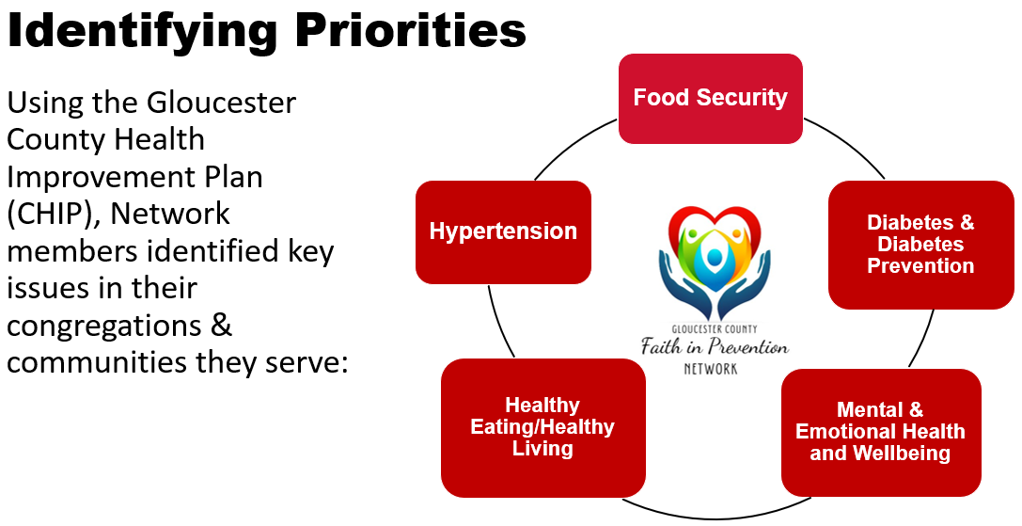
Faith-Based Prevention Networks: Collaborative Drivers of Health Equity and Food Security
Luanne J. Hughes, MS, RDN & Julie Frazee, MS, RDN
Rutgers Cooperative Extension, Dept. of Family & Community Health Sciences
Abstract
Objectives
Describe the role of faith-based networks in advancing community-driven strategies for health equity and food security.
Identify key components and best practices for building and sustaining collaborative prevention networks rooted in faith communities.
Analyze the impact of cross-sector partnerships involving faith organizations on public health outcomes and community well-being.
Methods
This session introduces the Faith in Prevention Network (FIPN) as an innovative outreach tool to build relationships with faith communities and support public and community health outreach.
COLLABORATE: Connect faith communities across a region with other faith communities that are invested in health, wellness, and reducing health disparities.
INVOLVE: Actively reach out to faith communities to welcome them into the network.
SUPPORT: Assist faith communities in developing their own passion for promoting food security, health, and wellness.
CONNECT: Connect faith communities and public health and social services agencies/organizations to share services and achieve common goals.
BUILD: Serve as a resource for faith communities to create, sustain, and evaluate health and wellness-related ministry programs.
Background/Intro.
NPY
POMC
Faith-Based Organizations (FBOs) increasingly are called on to serve in efforts to improve health, health equity, well-being, and food access. Their capacity to reach underserved populations experiencing the nation’s worst health inequalities has led to successful health and social services initiatives. Yet, it can be challenging to reach them and develop a rapport.
With the absence of countywide health/food security coalitions, we identified an opportunity to establish a group that brought together faith leaders and community programs to share resources, trainings, peer-to-peer support, mentoring, and funding support to assist in promoting healthier lifestyles for individuals, families, and communities: The Faith in Prevention Network (FIPN).
Vision:
Empower faith communities to serve as changemakers who work collaboratively within their congregations and communities to help families and individuals thrive physically, mentally, and spiritually.
Program Overview
Led by Cooperative Extension, monthly meetings:
Feature speakers who introduce members to resources/services to support their outreach;
Nurture the development of partnerships between members and guests/speakers;
Offer opportunities for members to share information about programs/initiatives;
Help members identify opportunities for collaborative projects and funding streams;
Offer opportunities to share best practices and experiences in establishing supportive services for congregations and communities.
The FIPN connects members to grant opportunities and resources like pantry supplies/counseling services; introductions to support gleaning, family caregiver, and homelessness initiatives; introduces Cooperative Extension programming; connects them with County services; and connects members to state organizations, giving them an audience with state "players".
NPY
POMC
Recruitment & Retention Strategies
Contacting Existing Partners & Collaborators
Recruitment Flyers
Neighborhood Canvassing
Community Mapping
Promotion/Marketing via:
  E-Mail
  In-Person Visits
  Phone Calls (Initial & Follow Up)
  Word of Mouth
  Facebook & Facebook Messenger
Qualtrics Evaluation:
  Value
  Application
Conclusion
Engaging with FBOs can expand and strengthen community outreach initiatives, because of their unique capacity to reach underserved communities.
Forming a Faith in Prevention Network can help public health, human services, & social services programs and FBOs establish trust, build partnerships, and collaborate on projects.

