Slide 1
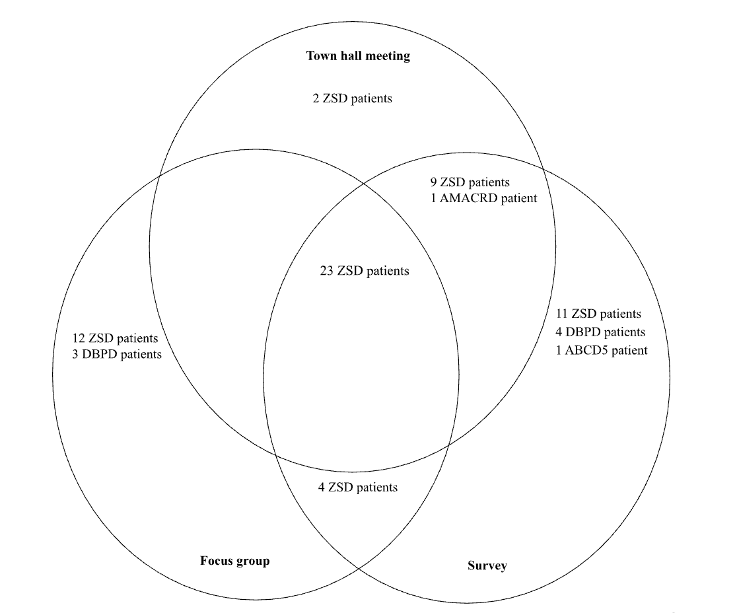
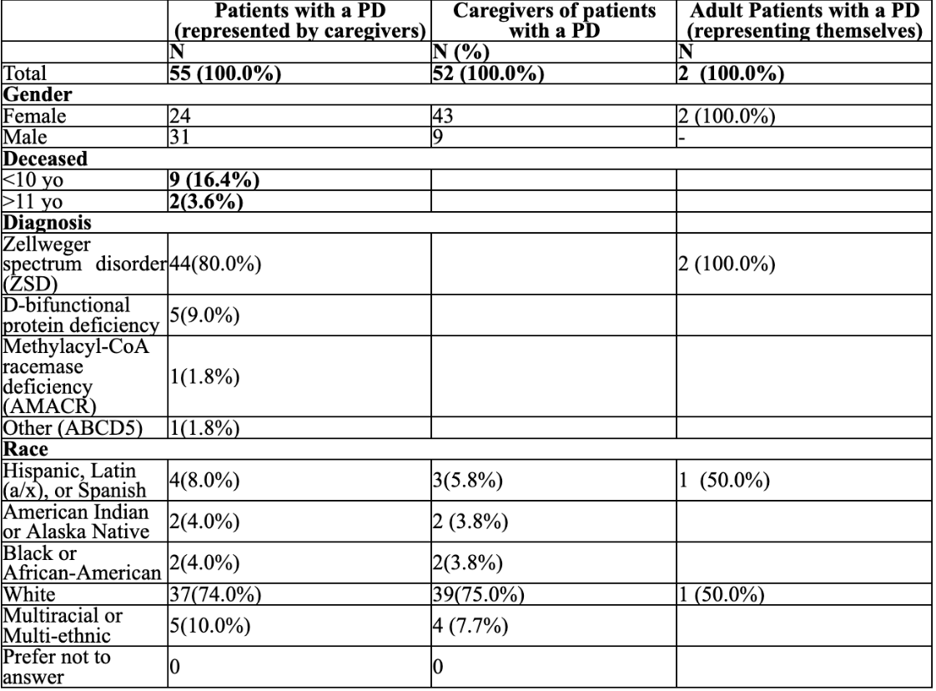
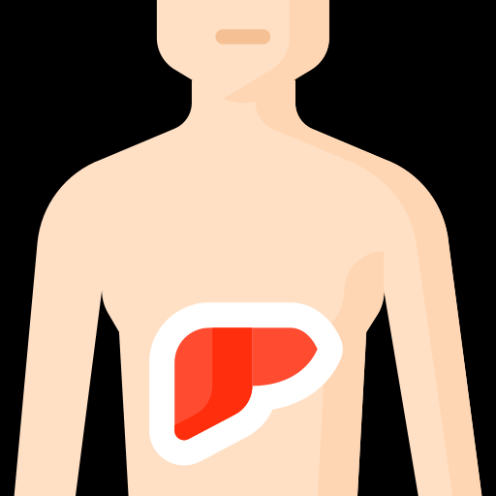


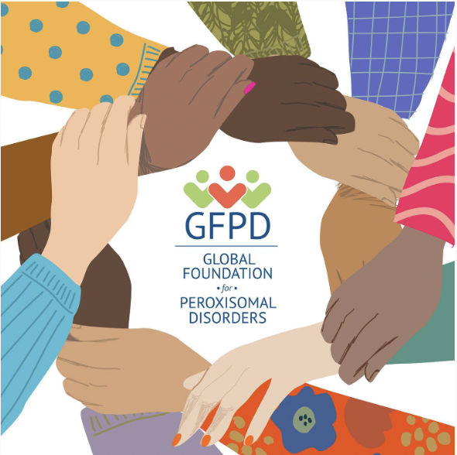
Assessment of gastrointestinal symptoms, impacts, and treatments in patients affected by peroxisomal disorders
Sarah Liz, MS; Mousumi Bose, PhD; Lauren M. Dinour, PhD, RDN, CLC; Nancy L. von Thun, RDN
Results
Results: Demographics
Figure 1: Individual patients represented
Demographics were similar across the survey, focus groups, interviews, and the town hall meeting.
Patients represented by either themselves or by their caregivers, primarily identified as being White, female, living, and diagnosed with ZSD.
Background
Table 1: Survey demographics
Peroxisomal disorders (PD) are rare genetic conditions that impact multiple organs. Among other symptoms, gastrointestinal (GI) issues, including liver dysfunction and bleeding, often affect patients' health outcomes. Liver dysfunction can be attributed to poor metabolism of bile acid intermediates into the primary bile acids necessary for adequate absorption of fat-soluble nutrients. Liver dysfunction may also lead to vitamin K deficiency and coagulopathy. Therefore, liver disease may lead to bleeding issues and nutrient deficiencies. Currently, limited treatments for PD exist, and there are few reports on the side effects of treatments. Primary bile acid supplementation of cholic acid and chenodeoxycholic acid may reduce liver inflammation by minimizing the accumulation of toxic bile acid intermediates. Although cholic acid therapy, or Cholbam, is the only FDA-approved medication for liver dysfunction in PD patients, previous studies and clinical trials report no meaningful improvements in liver issues. Likewise, there are no standardized treatments for bleeding issues in PD.
Purpose:
1. To characterize the specific GI symptoms and the impacts experienced by patients affected by PD, based on direct feedback from caregivers and patients.
2. To evaluate the efficacy of current treatments, side effects, and the management of GI symptoms in patients with PD.
Results: Symptoms, impacts, and treatments
Liver dysfunction
Intestinal varices and bleeding
Hospitalizations
“His liver. It's the texture..like it’s thickened so I worry about his liver help.”
“Liver disease progression is what killed [our child] ultimately.”
“That [my child’s] liver could kill her and that there's literally nothing that could be done about that.”
“ But now he's having problems with his liver, and the liver cirrhosis and GI bleeds and stuff like that.”
“the bleeding esophageal varices. I mean, they're just constant…he started having GI bleeds when he was 4”
[My child], has portal hypertension and esophageal varices, both of which caused GI bleeding issues…We've seen him throw up a large enough amount of blood due to a burst varyx in his esophagus to require a blood transfusion.”
“and then the bleeding esophageal varices. I mean, they're just constant admissions and issues.”
“She was hospitalized for failure to thrive and malnutrition.”
“She was admitted to the hospital where she received her very first blood transfusion, and an endoscopy was ordered to find the bleeding and stop it…she would be in the hospital or outpatient clinic for a minimum of 8 hours.”
Liver disease in PD patients may cause bleeding complications and frequent hospitalizations…these patients face a higher risk of death and cancer without effective treatments
Efficacy of liver and bleeding treatments
Side effects of bleeding treatments
Side effects of liver treatments
“So [my child’s] on Cholbam, and he's been on it since he was one, and for, like several years there was no change to his blood work.”
“and his GI took him off [of Cholbam] because she didn't see much benefit for him”
“He needed to receive many transfusions, plasma and he had to undergo many tests to try and find the problem”
“and in his life he had well over 100 blood transfusions. And it started in 2019 and kind of increased in frequency.”
“Her veins became so weak, eventually leading to surgery to have a port placed so she could have an easy access point to receive the lifesaving blood.”
“We tried the Cholbam for her liver, but she experienced severe abdominal pain with it. and it took us a while to figure out that it was the Cholbam causing the pain.”
“she was also on Cholbam. So which would affect her diaper outcomes, I say that. But you know they could be very acidic, which would lead to such a horrible diaper rash that we are literally doing wound treatments like she was a burn patient. ”
Figure 2: % of GI symptoms in PD
Figure 2: % of significantly impacted symptoms in PD
Methods
Data Collection
  Semi-structured virtual Zoom focus groups/interviews
  A web-based survey
  In-person polling and a semi-structured town hall discussion. The Global Foundation for Peroxisomal Disorders (GFPD) advocacy organization assisted with participant email outreach.
Data Analysis
  Quantitative
    Survey
      Frequency and number of survey respondents for GI symptoms, top 3 ranked GI/feeding-related symptoms, Likert scale question rating from 1-10 → descriptive statistics such as mean scores, and standard error of the mean, independent samples t-test to test for significant differences across groups
    Polling
      Frequency and percentage of responses
  Qualitative
    Focus groups/interviews
      Theme consensus, theme saturation across focus groups, recurrent themes
    Facilitated group discussion
      Development of formal codebook of themes based on consensus, themes organized using qualitative data analysis software, recurrent themes
    Open-ended survey responses
      Recurrent themes
Figure 3: % of GI treatments in PD
Figure 2 % of GI symptoms in PD
Discussion
PD patients frequently reported liver dysfunction. Caregivers attributed liver dysfunction in PD to being associated with portal hypertension, varices, intestinal bleeding, and death. This research connects the pain, length, and ongoing hospital admissions as an impact on patients experiencing potentially life-threatening bleeding. Based on direct feedback from patients and caregivers, Cholbam inadequately treats liver dysfunction in PD, and side effects worsen GI symptoms. Also, transfusions did not effectively manage bleeding issues.
Without proper care, patients experiencing liver dysfunction are vulnerable to high-risk outcomes related to chronic liver disease. Liver cancer and death are potential consequences of the end stage of liver cirrhosis, which has been reported in certain PD patients. Future clinical trials should have meaningful endpoints that address liver dysfunction and bleeding and explore effective treatment options for these symptoms. Additional research is needed to validate the origin of portal hypertension and intestinal bleeding in PD cirrhosis.
Conclusion: Liver issues have considerable impacts on PD patients, severely affecting their health, nutrition, and daily lives. This study serves as an initial step to assist health professionals and product developers in treating liver dysfunction and bleeding, improving growth and developmental outcomes in PD patients, and creating meaningful improvements in the quality of life of families with PD.
References
Braverman, N. E., Raymond, G. V., Rizzo, W. B., Moser, A. B., Wilkinson, M. E., Stone, E. M., Steinberg, S. J., Wangler, M. F., Rush, E. T., Hacia, J. G., & Bose, M. (2016). Peroxisome biogenesis disorders in the Zellweger spectrum: An overview of current diagnosis, clinical manifestations, and treatment guidelines. Molecular genetics and metabolism, 117(3), 313–321. https://doi.org/10.1016/j.ymgme.2015.12.009
Klouwer, F.C.C., Berendse, K., Ferdinandusse, S. et al. Zellweger spectrum disorders: clinical overview and management approach. Orphanet J Rare Dis 10, 151 (2015). https://doi.org/10.1186/s13023-015-0368-9

