Slide 1
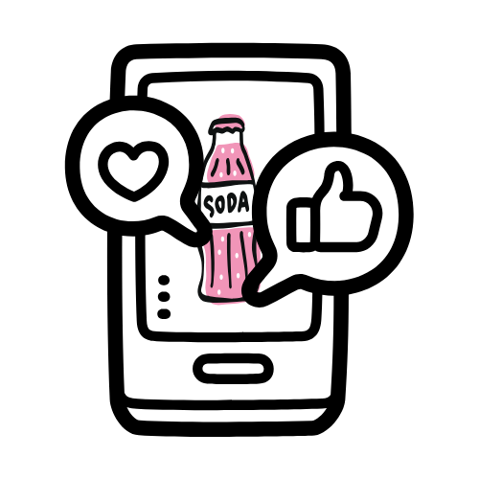

The Association Between the Frequency of Social Media Use and Soda Drinking Among U.S. High School Students
Paige Dellosso; Lauren Dinour DrPH, RD, CLC; Adrian Kerrihard, PhD; Jessica Bihuniak, PhD, RD
Montclair State University
TRANSCEND
U.S. high school
students who use social media frequently are
43% more likely to
drink any soda.
Results
Any soda drinking (95% C.I. for EXP(B))
Variable | S.E. | Sig | Exp(B) | Lower | Upper
Grade level | 0.022 | <0.001 | 0.899 | 0.862 | 0.938
Female | 0.050 | <0.001 | 0.709 | 0.643 | 0.782
Frequent social media use | 0.058 | <0.001 | 1.430 | 1.276 | 1.603
Felt sad or hopeless | 0.052 | <0.001 | 1.241 | 1.122 | 1.374
Any electronic vaping | 0.069 | <0.001 | 1.868 | 1.633 | 2.138
Introduction
Over 95% of teens aged 13 to 17 report using a social media platform, and more than a third say they use social media “almost constantly”.¹
Soda companies like Coca-Cola and Pepsi use social media to tailor their advertising to resonate with youth culture and current trends.²
This study aims to explore the relationship between the frequency of social media use and soda drinking among high school students.
Methods
Note: Variables that were excluded due to forward stepwise approach are overweight, obesity, Hispanic or Latino, electronically bullied, transgender, physically active, unstable housing, slept 8 hours, and any cigarette smoking. Hosmer and Lemeshow Test Sig. 0.788. Cox & Snell R Square 0.023. Nagelkerke R Square 0.034.
Data from the Center’s for Disease Control (CDC) Youth Risk Behavior Survey (YRBS) were analyzed using bivariate logistic regression.
Fifteen questions related to health behaviors and demographic characteristics were taken from the 2023 National High School Student Survey to analyze this relationship.
The forward stepwise likelihood ratio was employed to sequentially introduce variables based on their likelihood-ratio p-values, aiming to identify the most optimal model.
High school students who reported using social media more than once a day have 43% greater odds of drinking any soda at all compared to their counterparts (p<0.001).
Grade level, gender, frequent social media use, feelings of sadness or hopelessness, and any electronic vaping are the strongest predictors of drinking any soda in a one-week time frame.
Demographics
Conclusions
Characteristic | Total | Frequent social media use n (%) | Not frequent social media use n (%) | p
Grade level 9th 10th 11th 12th Ungraded Total Gender Female Male Total | 4,405 4,055 3,552 3,127 28 15,167 7,499 7,608 15,107 | 3,317 (75.3%) 3,194 (78.8%) 2,817 (79.3%) 2,502 (80.0%) 14 (50%) 11,844 (78.1%) 6,242 (83.2%) 5,573 (73.3%) 11,815 (78.2%) | 1,088 (24.7%) 861 (21.2%) 735 (20.7%) 625 (20.0%) 14 (50%) 3,323 (21.9%) 1,257 (16.8%) 2,035 (26.7%) 3,292 (21.8%) | <0.001 <0.001
The findings of this study underscore the importance of considering multiple factors when studying the relationship between the frequency of social media use and soda drinking.
Interventions targeting improved dietary habits among adolescents may benefit from leveraging social media to promote healthy behaviors, such as decreasing the consumption of sugar-sweetened beverages.³
References
1. Vogels E, Gelles-Watnick R, Massarat N. Teens, social media and technology 2022. Pew Research Center. Published August 10, 2022. https://www.pewresearch.org/internet/2022/08/10/teens-social-media-and-technology-2022/
2. Brownbill, AL, Miller CL, Braunack-Mayer AJ. The marketing of sugar-sweetened beverages to young people on Facebook. Australian and New Zealand Journal of Public Health. 2018;42(4):354-360. doi:https://doi.org/10.1111/1753-6405.12801
3. Hawkins L, Farrow C, Clayton M, Thomas JM. Can social media be used to increase fruit and vegetable consumption? A pilot intervention study. Digit Health. 2024;10:20552076241241262. doi:10.1177/20552076241241262
Note: “Frequent social media use” indicates using social media more than once per day. “Not frequent social media use” indicates using social media once a day or less. A statistically significant value is p<0.05. Percentages are calculated by dividing the number of students in each category by the total number of students horizontally. Percentages represent the number of students who either use social media frequently or do not use social media frequently in each category.

