Slide 1


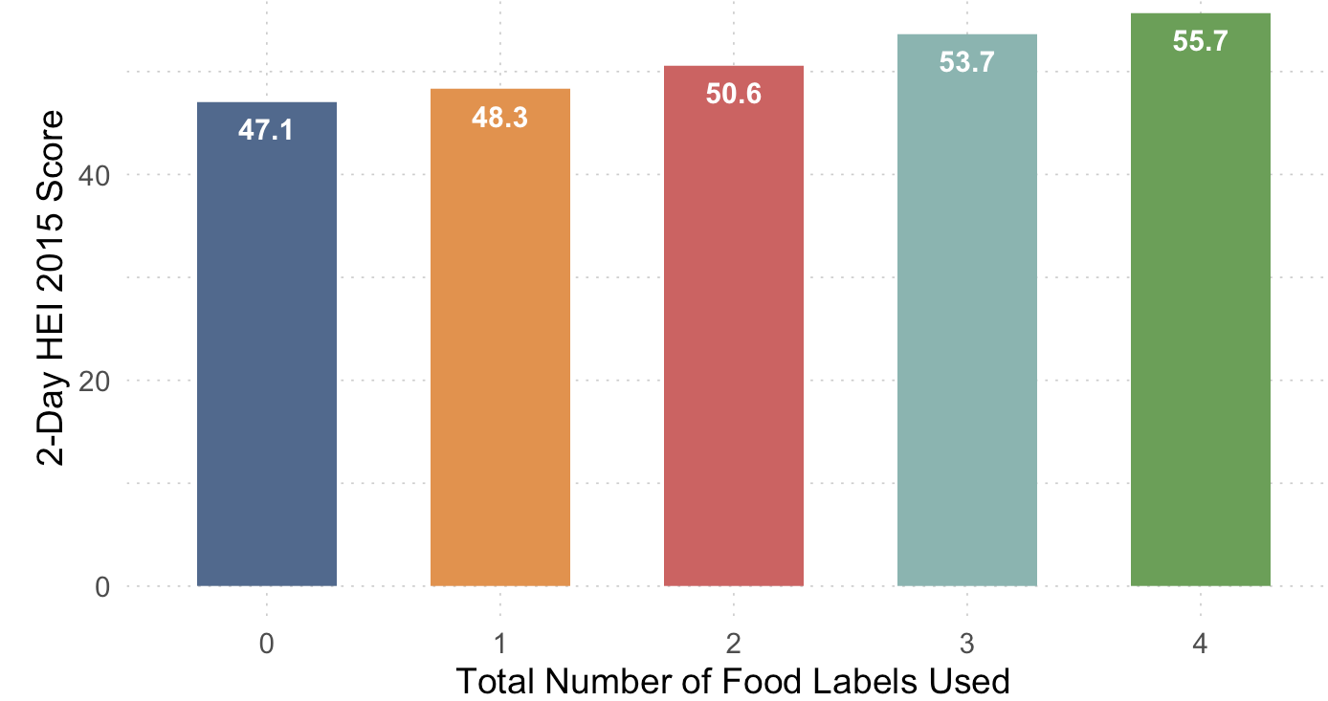
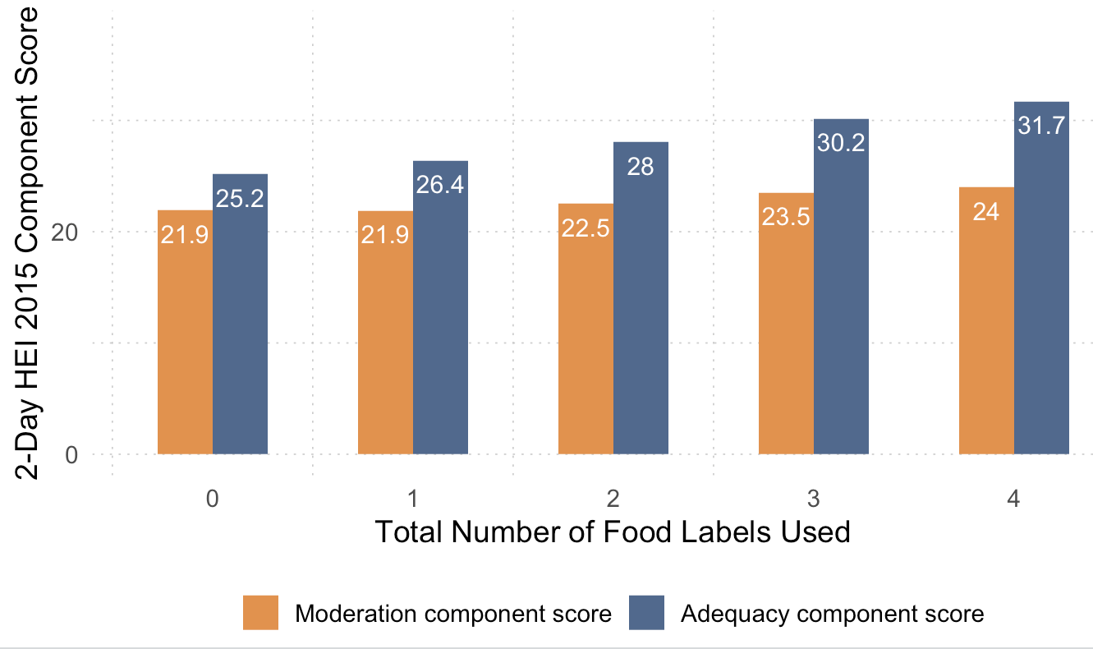
Nutrition Label Use and Associations with Dietary Quality Among a Nationally Representative Sample of US Adults.
Hailey Powell, MPH, MPP; Isabel Madzorera, ScD
UC Berkeley School of Public Health
Introduction
Despite modest improvements over the past two decades, diet quality among U.S. adults remains suboptimal, with Healthy Eating Index (HEI) scores still falling short of national recommendations.¹
Food labeling is an important strategy for promoting healthier eating. Prior research shows that using nutrition labels is associated with better dietary quality.²⁻⁴ However, most studies focus on individual labels in isolation and do not examine cumulative effects across different label types.
As the FDA explores front-of-package labeling, evidence on how multiple label types relate to diet quality can strengthen this rulemaking effort.
Figure 1. Mean Total HEI-2015 Score by Food Labels Used
Results
Participants using all four labels had a 7.3-point higher HEI score compared to those using none (p < 0.001).
Adequacy component scores increased by 4.1 points from 0 to 4 labels (p < 0.001).
Moderation component scores improved by 3.2 points across the same range (p < 0.001).
Across all models, greater food label use was significantly associated with higher dietary quality, as measured by the HEI-2015 (p-trend < 0.001).
Discussion
This study builds on prior research by showing that using multiple types of food labels is more strongly associated with higher overall dietary quality than using no food label.
This study reinforces and extends prior evidence that food label use is associated with improved dietary quality. We found that using multiple types of food labels ,was more strongly associated with higher HEI-2015 scores than using no label at all.
A dose-response relationship emerged, particularly for adequacy components suggesting label use may be more effective in promoting healthy food choices than in limiting less healthy ones.
These associations remained significant after adjusting for sociodemographic and behavioral factors and may reflect greater nutrition awareness or motivation among those who engage with multiple label types.
Objectives
1) To examine the association between multiple food label use and overall diet quality (HEI-2015 total score).
2) To assess the association between label use and the moderation components of HEI-2015.
3) To assess the association between label use and the adequacy components of HEI-2015.
Figure 2. Mean HEI-2015 Component Scores by Food Labels Used
Methods
Data Source
National Health and Nutrition Examination Survey (NHANES), 2017–2020 — a nationally representative, cross-sectional survey of the U.S. population.
Sample and Study Design
Adults aged 20 years and older (n = 6,364) with:
Complete exposure and outcome data
Plausible energy intake values
Secondary data analysis using:
Multiple imputation for missing covariates
Weighted multivariable linear regression
Trend testing across food label use categories
Measures:
Exposure: Total food label use (0–4), sum of four binary indicators
Outcomes: Total HEI-2015, adequacy score (ex. whole grains and whole fruit), moderation score (ex. refined grains and sodium).
Covariates: Sociodemographic characteristics and health behaviors
.
Conclusion
These findings support the FDA’s proposed standardized front-of-package (FOP) labeling rule by highlighting a potential gap: current food labeling may be more effective at promoting the intake of healthy foods than limiting the consumption of less healthy ones.
Nutrition education programs should teach comprehensive label literacy to help individuals make more informed food choices.
Table 1. Regression Coefficients for HEI Outcomes by Label Use.
Labels Used | Total HEI β (p) | Adequacy HEI β (p) | Moderation HEI β (p)
1 | 1.92 (.061) | 1.61 (.018)* | 0.23 (.660)
2 | 3.96 (.002) ** | 2.86 (<.001)*** | 0.94 (.131)
3 | 5.84 (<.001)*** | 4.03 (<.001)*** | 1.52 (.003)**
4 | 6.52 (<.001)*** | 4.73 (<.001)*** | 1.58 (.003)**
References
Liu J, Mozaffarian D. Trends in Diet Quality Among U.S. Adults From 1999 to 2020 by Race, Ethnicity, and Socioeconomic Disadvantage. Ann Intern Med. 2024;177(7):841-850. doi:10.7326/M24-01902.
Shangguan, S., Afshin, A., Shulkin, M.,Ma, W., Marsden, D., Smith, J., Saheb-Kashaf,M., Shi, P., Micha, R., Imamura, F., & Mozaffarian, D. (2019).A Meta-analysis of Food Labeling Effects on Consumer Diet Behaviors and Industry Practices. American Journal of Preventive Medicine,56(2), 300–314.https://doi.org/10.1016/j.amepre.2018.09.0247.
Anastasiou, K., Miller, M., & Dickinson, K. (2019). The relationship between food label use and dietary intake in adults: A systematic review. Appetite,138, 280–291.https://doi.org/10.1016/j.appet.2019.03.025
Storz, M. A. (2023). Nutrition facts labels: Who is actually reading them and does it help in meeting intake recommendations for nutrients of public health concern? BMC PublicHealth,23(1), 1947.https://doi.org/10.1186/s12889-023-16859-213.
Significance levels: * p < 0.05; ** p < 0.01; *** p < 0.001; A significant linear trend was observed across categories of food label use across all outcomes (p-trend < 0.001); 0 food labels is the baseline exposure.

