Slide 1
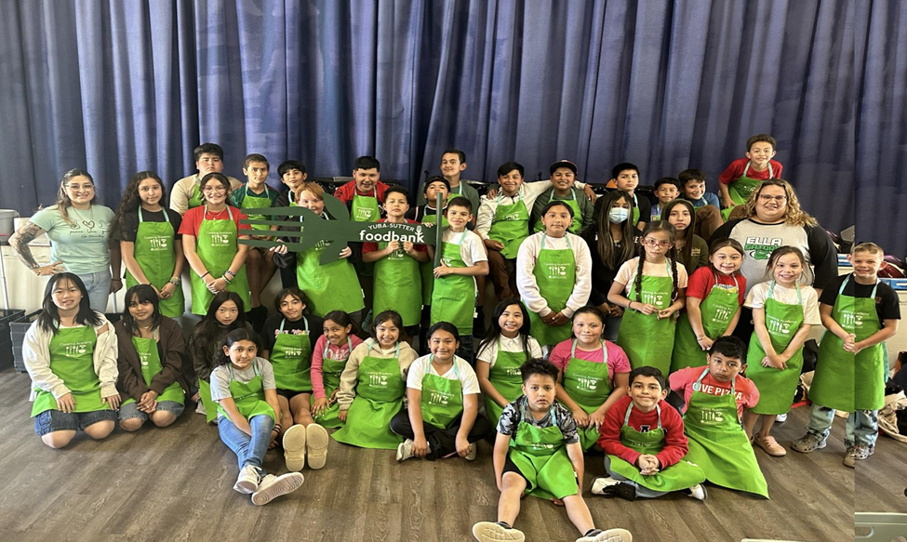
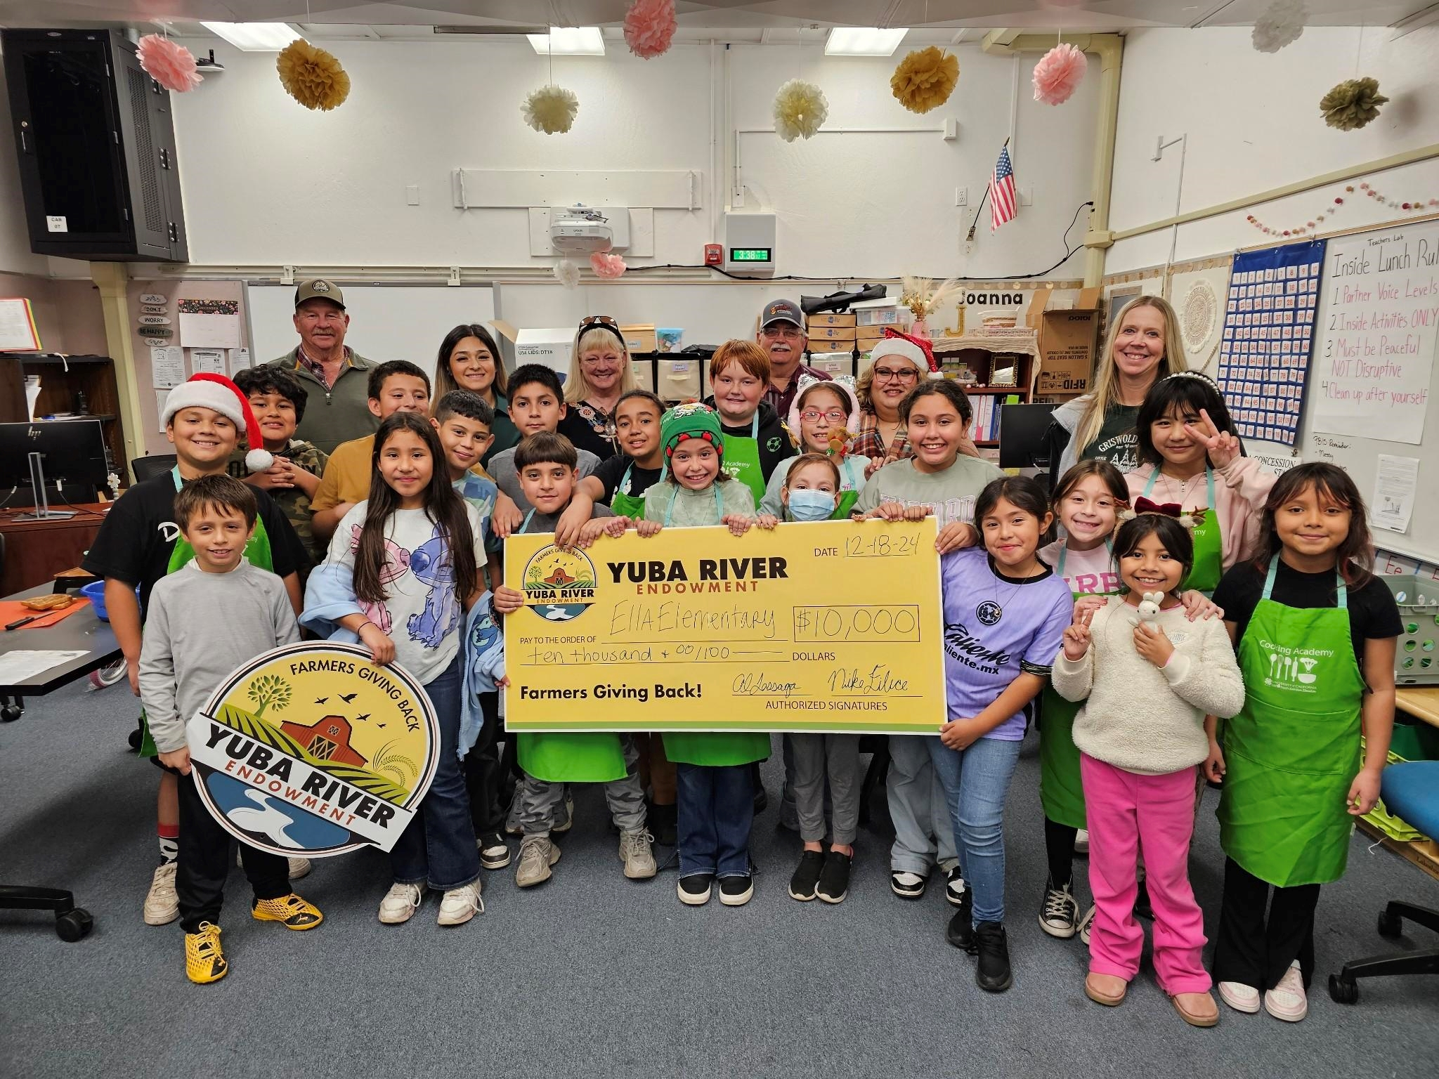



Ella Elementary Serves Up "Cool"inary Cooking Club with Community Support
Impact over Intent
Ella Elementary School (home of the Ella-Gators!) is in Yuba County, about 40 miles north of Sacramento. In the ‘23-’24 school year, CalFresh Healthy Living, University of California Cooperative Extension, in collaboration with the Sutter-Yuba 4-H Program, trained Ella Elementary School’s after school program coordinators to use the Cooking Academy Curriculum to develop the “Cool”inary Cooking Club for 60 students in 2nd - 6th grade.
Joanna Leal, from Ella Elementary School’s After School Program led the development of the Coolinary Club. She said:“If it wasn't for community partnerships, we could not have had this huge success.Thank you to the Marysville Police Department who donated about $250 to help us purchase some materials, and the Yuba Sutter Food Bank who allowed us to shop at the food bank for the ingredients needed for our creations once a month.”
The After School Program Educators observed the impact their club had on their students and their school’s community.
“We love the positive feedback from parents, their kids are more involved at home in the kitchen. They come home from school excited and share what they did.It is rewarding to see how our once small idea of creating a cooking club has made an impact [on] not only our school, but our community.”
Ella Elementary School received an endowment award of $10,000 for their "Cool"inary Club and School Garden. In the 2025 school year, they are making plans with CalFresh Healthy Living, UCCE Butte Cluster Community Education Specialist, Adam Yandel, to incorporate their garden produce into the recipes that they make.
University of California Cooperative Extension Yuba County | Veronica VanCleave-Hunt vvancleavehunt@ucanr.edu| Melissa Ussery melvang@ucanr.edu
Funded by USDA SNAP, an equal opportunity provider..
Notes:
To ensure ADA Compliance please follow the formatting mentioned here and demonstrated in the slides above.
The funding statement found at the bottom of the slide should only be resized to accommodate multiple logos.
When adding your logo, be sure to had Alt Text to describe your entity for ADA Compliance.
Body copy must be set in Arial font, no less than 38pt.
The title font size should remain unchanged unless the title length requires it. Header font size must remain larger than 72pt and in Bold.
The text box shown in the example slide can accommodate roughly 375 characters, not counting spaces. Please stay within the character count.
All images must have Alternate Text, meaning that a brief description must be included describing the image for those using a screen reader. Simply insert an image > right-click on the image > select Edit Alt Text > and include the description.
We provided guidelines so you know how far the content should extend on the slide, simply turn on the Guides under the View tab.
Please hide or delete any unused slides.

