Slide 1

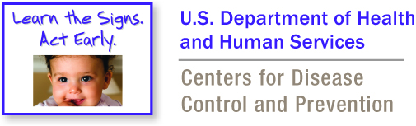
Developmental Monitoring Program for WIC
Annual Survey Results 2024-2025

Slide 2
2024-2025 Survey
A survey was conducted in August 2025 to gather feedback from both state level and clinic level WIC staff about the DM Project for WIC. We gathered feedback on both the 2024-2025 year (October 2024-September 2025) and the full 7-year project (2018-2025). There was a separate survey for state level staff and clinic level staff. This is a high-level overview of the highlights. For more details about these results, please contact AmberBrown@asphn.org.
Supported State Survey*
4 states completed (LA, ND, WV, WI)
Learning Collaborative State
Survey
14 states completed (AR, GU, HI, ME, MA, MD, MO, NH, OH, PR, RI, SC, TX, UT)
Clinic Staff Survey
89 clinic staff completed (SC-45, MA-11, ND-11, LA-7, WV-6, WI-5, AR-3)
Notes:
*Supported States received support from ASPHN/CDC in the form of LTSAE program materials and technical assistance to implement developmental monitoring between January and September 2025.
Supported State Survey – LA, ND, WV, WI
Learning Collaborative State Survey – AR, GU, HI, ME, MA, MD, MO, NH, OH, PR, RI, SC, TX, UT
Clinic Staff survey– (SC-45, MA-11, ND-11, LA-7, WV-6, WI-5, AR-3)

Slide 3
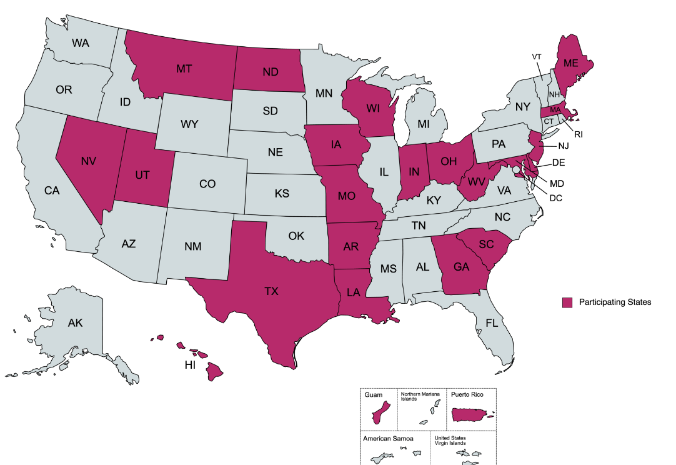
Combined Supported State & Learning Collaborative State Survey Results
Learning collaborative states and supported states were sent separate surveys (N=18). Most of the questions were the same. In this presentation you will find a high-level overview of the combined survey data. 17 states* have begun implementing DM using LTSAE materials.
  9 statewide* (GU, HI, MA, ME, MO, NH, NV, RI, SC)
  4 states have hopes to expand (AR, ND, WI, WV)
  13 have plans to continue their current efforts (GU, HI, LA, MA, MD, ME, MO, NH, OH, RI, SC, TX, UT)
94% felt well supported by ASPHN and CDC
    “Having the support from ASPHN helps me as a State office person keep on track with implementation plans and also supports me in keeping the local agencies on track with their implementation plans.”– Supported State who has expanded statewide
*based on survey data and communication with states.
Notes:
94% felt well supported by ASPHN and CDC (17/18)
States that have plans to continue their current efforts – LA, MO, UT, MD, RI, TX, OH, NH, ME, HI, MA, GU, SC
States that have plans to expand – AR, ND, WI, WV
PR is evaluating whether they can expand.

Slide 4
Supported State & Learning Collaboration State Data
Most commonly used LTSAE materials:
CDC’s milestone checklists (paper)
How states are encouraging the checklists in clinics:
Providing trainings on LTSAE
Showcasing success stories at state and/or regional meetings
WICShopper app developmental content
Participant education modules (WIChealth.org, WICSmart, WIC-ed.com, etc.)
CDC’s wall/floor graphics
CDC’s milestones matter brochures
CDC’s milestone tracker app
CDC’s milestones matter posters
CDC’s amazing children’s books
CDC’s website
Notes:
Most Commonly Used LTSAE Materials: (18 responses)
CDC’s Milestone Checklists (Paper) (15/18)
CDC’s Milestone Tracker App (13/18)
Participant Education Modules (WIChealth.org, WICSmart, WIC-ed.com, etc.) (8/18)
CDC’s Wall/Floor Graphics (8/18)
CDC’s Milestones Matter Brochures (8/18)
WICShopper App Developmental Content (8/18)
CDC’s Website (8/18)
Milestones Matter Posters (7/18)
CDC”s Amazing Children’s Books (6/18)
How States are Encouraging the Checklists in Clinics: (17 responses)
Providing trainings on LTSAE (9/17)
Showcasing success stories at state and/or regional meetings (6/17)

Slide 5
State Staff Survey Data
Barriers:
59% not enough frontline staff time
Suggestions for how ASPHN/CDC can better support staff:
Improve access to materials and printing funds
29% faced no barriers
41% hesitance to add another program or initiative
35% staff turnover
Continue monthly training
Offer refresher courses for experienced checklist users
Conduct survey with WIC participants
Support 1:1 state connections
Notes:
Barriers, select all that apply: (17 people responded)
59% not enough frontline staff time (10/17)
41% hesitance to add another program or initiative (7/17)
35% staff turnover (6/17)
29% faced no barriers (5/17)
In year 6 only 16% faced no barriers.
Suggestions for how we can better support you:
Easier access to materials and funds for printing costs
Continue monthly trainings
Refresher course for those who have been offering checklists for awhile.
Conduct a participant survey.
Facilitate states connecting 1:1.

Slide 6
Quotes from State Staff Surveys
“Continue to provide trainings for staff on topics appropriate to developmental monitoring/developmental delays including how nutrition education can tie into this program. I also like the networking opportunities for both state and local agency staff to share information about their project and learn from each other.”
“I've found this program to compliment the services that WIC provides nicely. It is one of the easiest programs to incorporate into the clinic setting. Talking about developmental milestones and feeding practices go hand in hand.”
“A positive experience I had while using the Developmental Milestone Checklist was when, during a re-cert, the mom of a 1.5-year-old child was very concerned about the child's speech and development, and it was making her feel anxious and stressed. As we went through the list together, she became more excited to see all the things that her child was already doing, such as pointing at objects or trying to say 2 or more words, and it helped ease her mind. She mentioned she hadn’t realized how many skills counted as milestones, and the checklist gave her confidence that her child was right on track. She left the appointment feeling proud and motivated to keep supporting her child’s development.”

Slide 7
Clinic Staff Survey Results
The clinic staff survey was sent to all supported state clinics offering the LTSAE checklist. Additionally technical assistance states were encouraged to send the survey to clinics offering the LTSAE checklist.
The first question in the survey asked if the staff member offers the checklist in their clinic. If they marked no, they were disqualified from the remainder of the survey.
Completed by 89 staff from AR, LA, MA, ND, SC, WV, WI
85 marked that they offer the checklists; 4 marked that they previously implemented, but not currently; 4 marked no. The 4 who have not implemented were disqualified from the rest of the survey.
Mostly nutritionists/CPAs
Most responders have been using the checklists for more than 1 year. (see table on the right)
Notes:
What is your position at WIC:
CPA/Nutritionist: 71% (63/89)
Office Staff: 3% (3/89)
Clinic/Agency Management: 10% (9/89)
Other: 16% (14/89)
Support staff, nurse, WIC director, family coordinator, lactation counselor, etc.
Most responders have been using the checklists for more than 1 year.
How long has your clinic been using the milestone checklists (in any format) with families?
Less than 6 months – 25% (21/84)
6 months to a year – 5.95% (5/84)
1-2 years – 32.14% (27/84)
More than 2 years – 35.71% (30/84)
Previously used checklists, but not currently – 1.19% (1/84)

Slide 8
Clinic Staff Survey Results
74% said that the checklist adds less than 5 minutes to the WIC appointment.
  30% answered less than 2 minutes
  41% answered 2-5 minutes
73% are using the paper checklists in person.
Most people use the checklists during at least half of all WIC visits.
  33% use them at about half of all visits
  31% use them at almost all visits
  10% use them at all visits
Notes:
How are milestone checklists administered: in person, virtually, or other? Select all that apply
In person using a paper checklist: 72.62% (61/84)
How much time does completing a milestone checklist with families add to your WIC appointments? Select one
2-5 minutes: 41.46% (34/82)
Less than 2 minutes: 30.49% (25/82)
In year 6, 65% said it adds less than 5 minutes
Since you started using the checklists, for about how many eligible visits did you use a milestone checklist (in any format) with families. Select one
About half of all visits: 32.53% (27/83)
Almost all visits: 31.33% (26/83)
Some visits: 22.89% (19/83)

Slide 9
Clinic Staff Survey Results
Most used LTSAE materials:
CDC’s paper milestone checklists: 71%
Problems getting started:
No problems: 57%
CDC’s Milestone Tracker App: 38%
CDC’s milestone brochures: 28%
Milestones matter nutrition education modules on WIChealth.org, WICSmart, WIC-ed.com, One by Nutrition Matters: 26%
Lack of time: 32%
Staff shortages: 13%
CDC’s website: 39%
CDC’s milestone moments booklet: 27%
CDC’s wall/floor graphics: 20%
Notes:
What resources do you regularly use at your clinic? Select all that apply. 84 total responses.
Did your clinic experience any problems with getting your Developmental Milestone Checklist Program started? Select all that apply. 82 responses
In year 6, 40% indicated no problems getting started.

Slide 10
Clinic Staff Survey Results
The percentages below are based on how many clinic staff agreed or strongly agreed to the statements on the right.
87%
The program is beneficial for WIC participants and the checklists are easy for the families to use
80%
Like offering milestone checklists to families
75%
Say the program is easy to administer to WIC families
81%
  Feel well supported by state staff in implementing the checklist program
Notes:
87% say the checklist program is a beneficial program for WIC families ((68/78)
87% say the checklists are easy for WIC families to use (66/76)
80% like offering the milestone checklists to WIC families (63/79)
75% say the program is easy to administer to WIC families (59/79)
81% feel well support by state staff in implementing the checklist program (61/75)

Slide 11
How clinic staff feel about the checklist program and their comfort levels
82% of staff always or usually feel comfortable supporting parents when they are concerned about their child’s development.
75% of staff always or usually felt comfortable talking to families about the results of the checklists.
Notes:
75% I feel comfortable talking to WIC families about the results of the checklists
(58/77).
82% feel comfortable supporting parents when they are concerned about their child’s development (62/76)
70% never or rarely received pushback from the families after providing a referral (50/71)
71% always or usually know when and where to refer children with possible delays. (53/75)

Slide 12
How clinic staff feel about the checklist program and their comfort levels (continued)
71% of staff always or usually know when or where to refer children with possible delays.
70% of staff never or rarely received pushback from families after providing a referral.
Notes:
75% I feel comfortable talking to WIC families about the results of the checklists
(58/77)
82% feel comfortable supporting parents when they are concerned about their child’s development (62/76)
70% never or rarely received pushback from the families after providing a referral (50/71)
71% always or usually know when and where to refer children with possible delays. (53/75)

Slide 13
Clinic Staff Survey Results
Suggestions for improving the WIC DM Program:
Allow extra time for developmental monitoring in WIC appointments
A test or measure to show results of developmental monitoring: Did their child truly benefit from the program? Did they receive the help they needed?
Guidance on coordinating with other healthcare providers who already use checklists
An electronic tool connected to the WIC record
Incorporate the milestones into the health history questionnaire
Having multiple languages available for LTSAE materials
Ask parents to complete the checklist before the appointment
Provide more developmental monitoring training and refresher courses
Offer clearer guidance on referral pathways when there is a developmental concern

Slide 14
When asked to provide a positive story about developmental monitoring in WIC, there were so many submitted. A few of them include:
“I feel the benefit overall is that it spurs awareness of the milestones for parents. Whether this is an individual's first child and they are learning about the concept of child development or they are a busy family with multiple children that might overlook milestones in the day-to-day chaos that sometimes occurs in large families, doing these checklists raises awareness and allows the focus to be on just that child.”
“Before administering the checklist, one mom had concerns that her 1 year child was developmentally behind, especially since another family member's child who is the same age was doing more/progressing faster in some areas than her child. After going through the checklist, she was much more at ease that her child was meeting their milestones appropriately. “
“We had a family of twins, who thought maybe their delays were within normal limits but after doing the checklist the mom asked for a referral because they were behind in most areas - she said, "I didn't realize they were supposed to be doing this many more things, I'm glad you're doing this here at WIC now! That family is now receiving early intervention.”
“We just have had great outcomes with the milestones. A lot of families don’t know that they can track their children’s milestones themselves with the app. It is so helpful in the society we live in, where social media and internet are a huge aspect of family's lives now. We love it!”

Slide 15

Key Takeaways From the Surveys
Developmental monitoring is being successfully integrated into WIC clinics with minimal impact on appointment length.
Both state and clinic staff value the program and report high satisfaction and confidence in supporting families.
Barriers remain around staff time, turnover, and workflow integration, but overall feedback shows that developmental monitoring is a practical, impactful addition to WIC services.

Slide 16
Next Steps
ASPHN and CDC will use the results of these surveys to inform our work during the next year of the project.
Please contact AmberBrown@asphn.org with any questions or for more details about the surveys.

