Slide 1
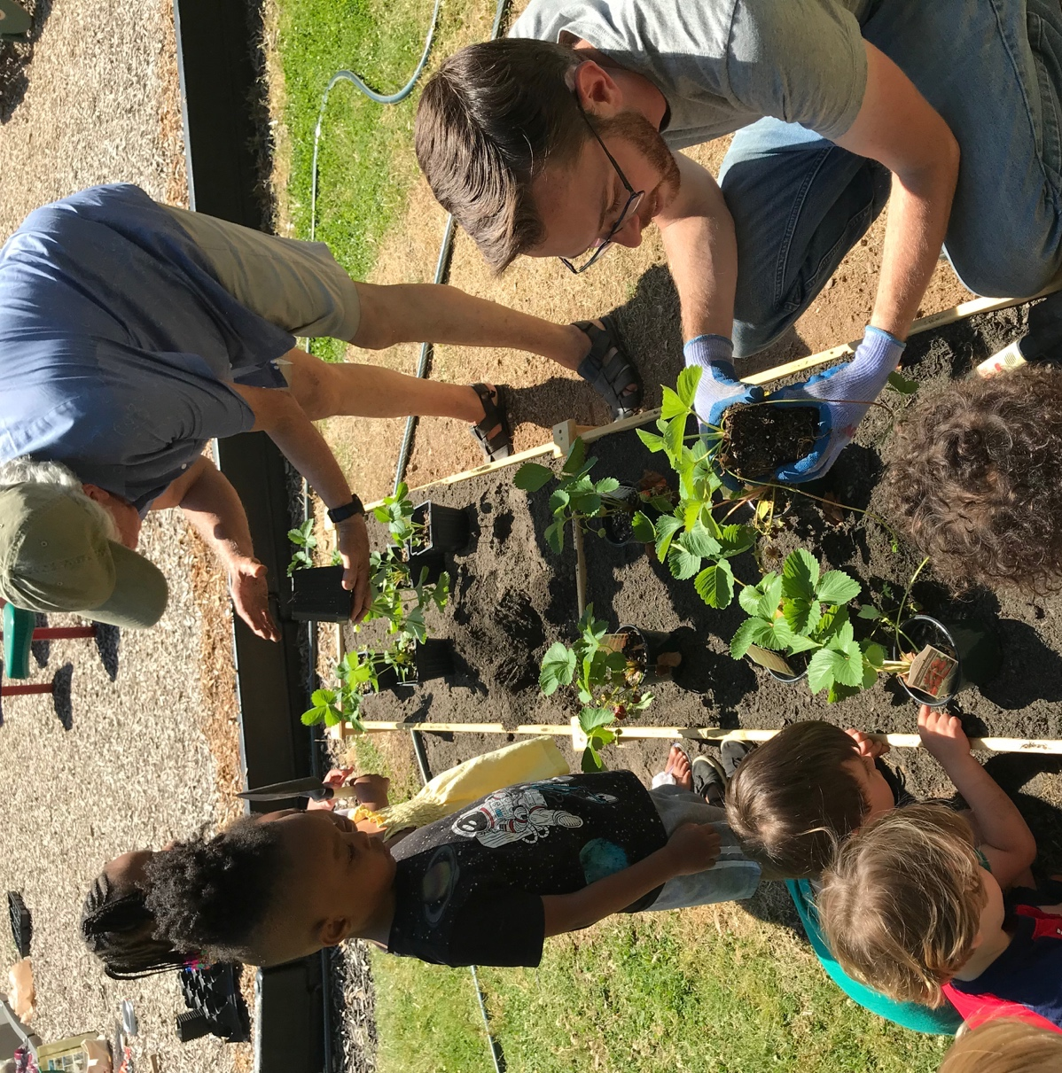

Childcare Outdoor Learning Environments as Active Food Systems: Effectiveness of the Preventing Obesity by Design (POD) Gardening Component
Healthy Eating & Physical Activity
by Gardening
Nilda Cosco, PhD
Research Professor, Director of Programs
Natural Learning Initiative (NLI)
College of Design, North Carolina (NC) State University
USDA-NIFA-AFRI-005845
Integrated Research. Education, Extension
Notes:
Introduce webinar.

Slide 2
Childcare Outdoor Learning Environments as Active Food Systems: Effectiveness of the Preventing Obesity by Design (POD) Gardening Component
Healthy Eating & Physical Activity
by Gardening
Nilda G. Cosco, PhD, College of Design, NC State University
Nancy M. Wells, PhD, College of Human Ecology, Cornell University
Robin C. Moore, MCP, HonASLA, College of Design, NC State University
Daowen Zhang, PhD, Statistics, NC State University
Derek Hales, PhD, Nutrition, University of NC-Chapel Hill
Muntazar Monsur, PhD, Landscape Architecture, Texas Tech University
L. Suzie Goodell, PhD, Food, Bioprocessing, and Nutrition Sciences, NC State University
Tong Xu, College of Human Ecology, Cornell University
Notes:
Introduce team that worked on Childcare Outdoor Learning Environments as Active Food Systems (COLEAFS).

Slide 3

Natural Learning Initiative (NLI)
www.naturalearning.org
North Carolina State University © All rights reserved
Notes:
The Natural Learning Initiative (NLI) is within the College of Design at North Carolina State University.
NIL is creating environments for healthy human development and a healthy biosphere for generations to come. NLI includes 5 areas of work including, design assistance, comprehensive projects, professional development, action research, and information dissemination, such as best practices.

Slide 4
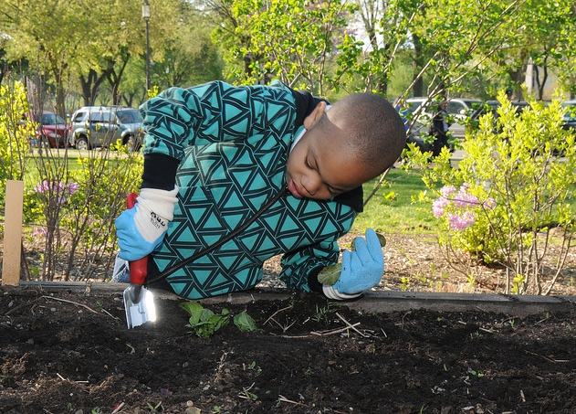
Introduction
Childcare Outdoor Learning Environments as Active Food Systems: Effectiveness of the Preventing Obesity by Design (POD) Gardening Components
Young children fall short of daily physical activity and Fruit and Vegetable (FV) consumption recommendations
Interventions early in life may be particularly effective at increasing physical activity
Gardening may promote physical activity and FV acceptance
Results may impact childcare practice, and policy making
Notes:
Introduction:
Young children fall short of daily physical activity and Fruit and Vegetable (FV) consumption recommendations
Interventions early in life may be particularly effective at increasing physical activity
Gardening may promote physical activity and FV acceptance
Results may impact childcare practice and policy making

Slide 5
Research Design
Randomized Controlled Trial, N=15 childcare sites
Childcare sites randomly assigned to one of three groups:
Group 1: Intervention (Year 1 Intervention) (5 childcare sites, 100 children)
Group 2: Wait List Control (Year 2 Intervention) (5 childcare sites, 100 children)
Group 3: Control (No Intervention) (5 childcare sites, 100 children)
15
childcare sites
Research design |  | True Experiment 1 |  |  |  |  | True Experiment 2
 |  | Year 1 |  |  |  |  | Year 2
Random assignment |  | Winter | Spring | Summer | Fall |  | Winter | Spring | Summer | Fall
Group 1- Intervention (5 sites/100 children) |  |  | O₁ | X | O₂
Group 2- Wait list (5 sites/100 children) |  |  | O₁ |  | O₂ |  |  | O₃ | X | O₄
Group 3- Control (5 sites/100 children) |  |  |  |  |  |  |  | O₃ |  | O₄
 |  | X Intervention |  |  |  |  | O Observation
10
FV gardens
31
teachers/
caregivers
Notes:
Describe research design:
COLEAFS was a Randomized Controlled Trial.
Fifteen childcare centers were randomly assigned to one of three groups:
Intervention (“Group 1,” n=5 centers, ~100 children)
Waitlist control (or “delayed intervention”) (“Group 2,” n=5 centers, ~100 children);
or the No-intervention control (“Group 3,” n=5 centers, ~100 children).
Garden installation took place in March each year. The gardening period was March through September.
Teachers agree to participate in two, 2-week data-gathering periods, and to complete a gardening record, called a Garden Fidelity Tool (“GaFT”). They also agree to engage in regular journaling of classroom activities and record anecdotal data.

Slide 6
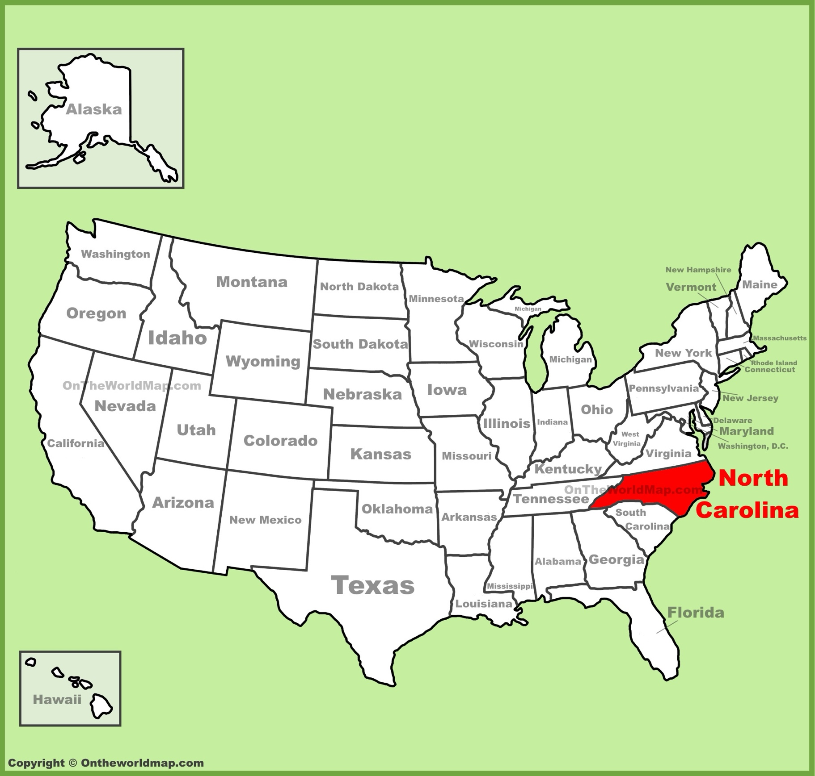
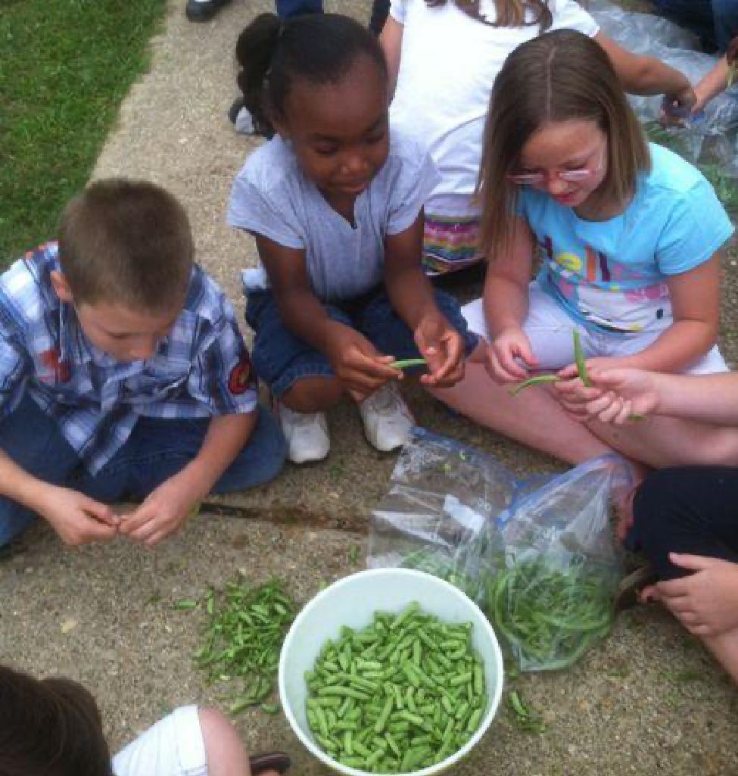
Participants & Centers
Childcare Centers
Located in Wake County, NC
51% families participated in the Child and
Adult Care Food Program (CACFP)
Operated year-round
Employed cooking staff
Children = 250
Averages
17 children / center
Age: 3.28
Body Mass Index: 16.10
Male: 49%
•
Notes:
Describe participants and sites:
Childcare Centers
Located in Wake County, NC
51% families participated in the Child and
Adult Care Food Program (CACFP)
Operated year-round
Employed cooking staff
Children = 250
Averages
17 children / center
Age: 3.28
Body Mass Index: 16.10
Male: 49%

Slide 7
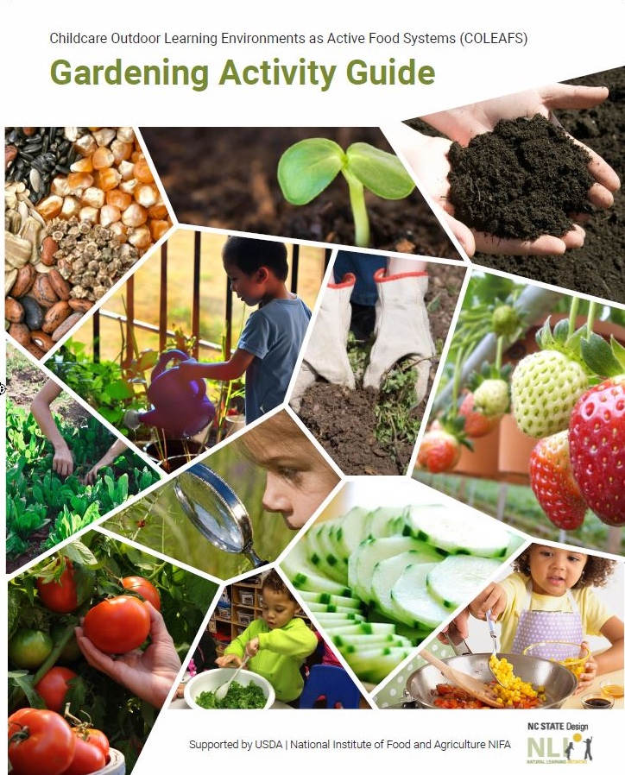
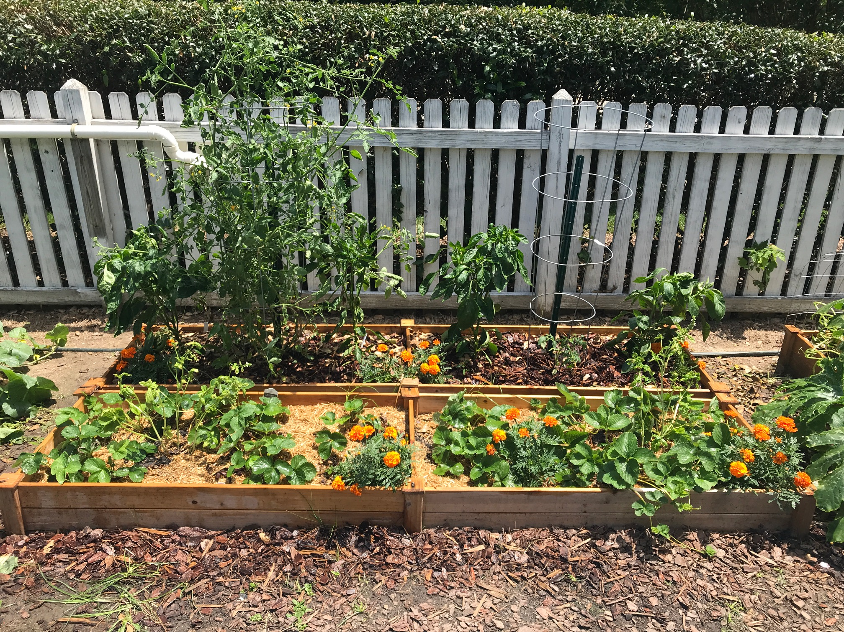
The Intervention
Garden installation
Gardening Activity Guide and Calendar (wall chart)
Weekly garden visit
Notes:
Describe the intervention components and resources.
The intervention included the garden installation (6 fruit and 6 vegetable gardens), the Garden Activity Guide booklet and a Wall chart to record activities, and the visit of a garden research assistant.

Slide 8
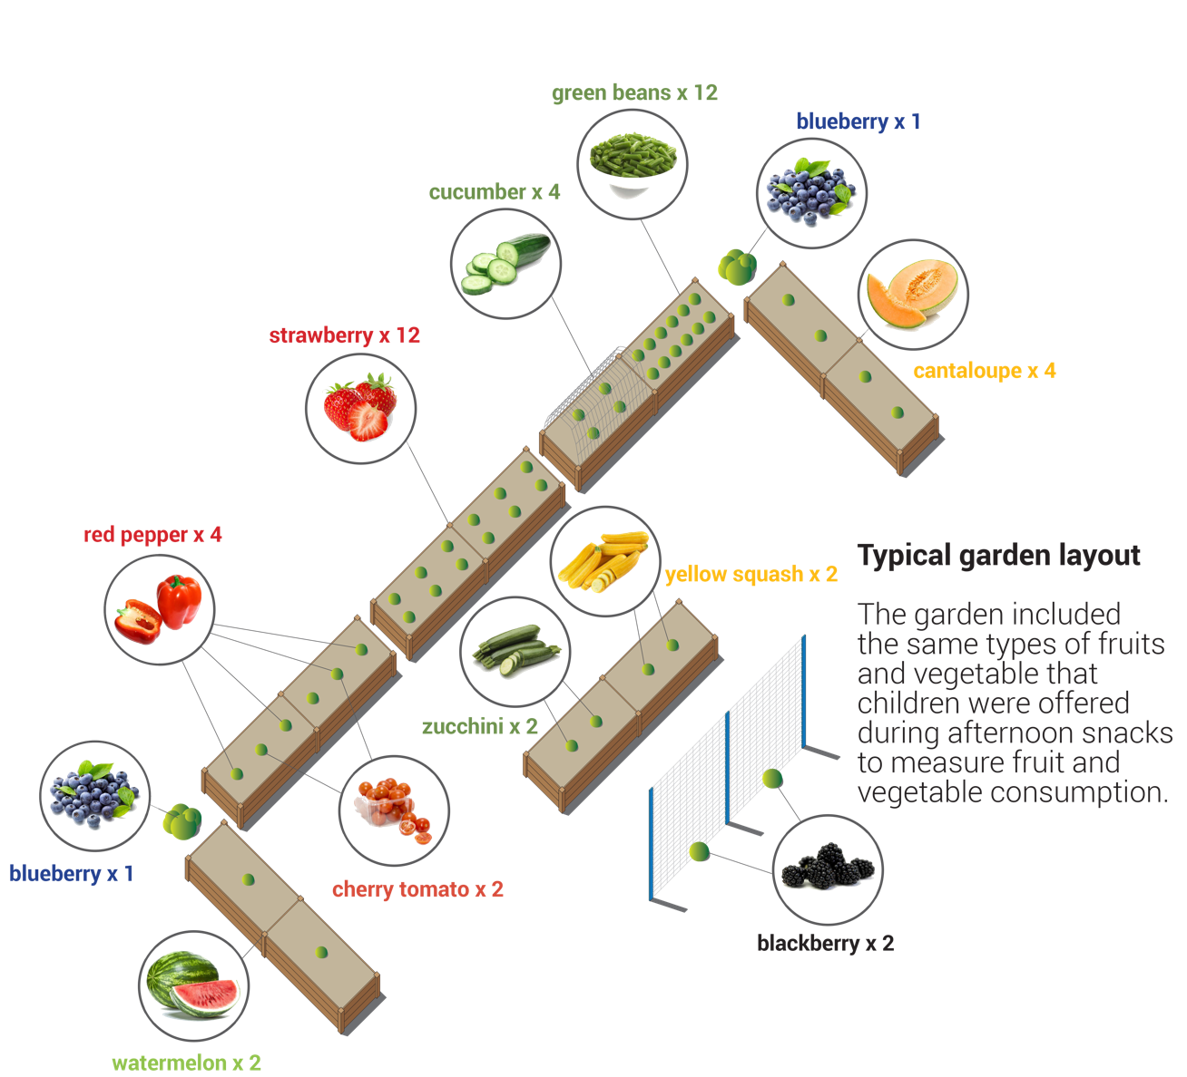
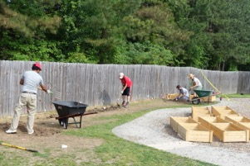
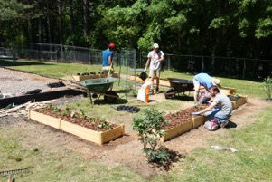
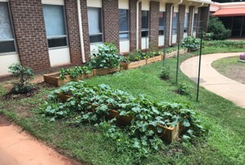
The Intervention
Notes:
The garden was:
Six 8’ x 2’ (10” high) raised beds
Planted with the the same Fruits and Vegetables that were offered during the snack sessions.
Fruit: blueberries, watermelon, blackberries, cantaloupe, strawberries
Veg: red pepper, cucumber, green beans, zucchini, yellow squash, cherry tomato

Slide 9
The Intervention
TWELVE GARDENING ACTIVITIES
  PREPARING
  Examining seeds and plants
  Sprouting seeds
  Preparing beds
  Planting
  CARING
  Watering
  Weeding
  Observing plant growth
  Observing garden bugs
  HARVESTING / EATING
  Harvesting
  Preparing
  Snacking
  Taking home
Notes:
The Garden Activity Guide booklet included 12 gardening activities and information about the fruits and vegetables planted in the garden.

Slide 10
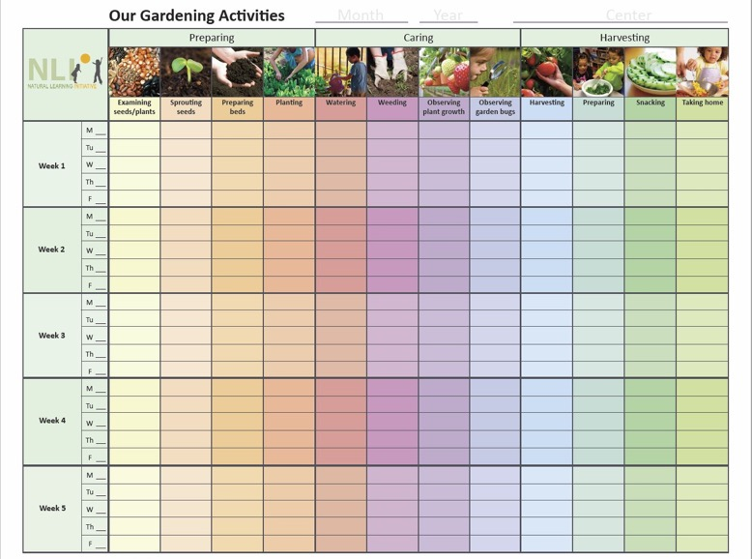
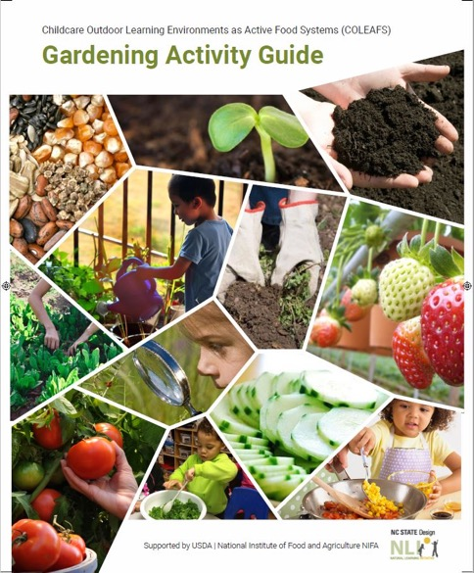
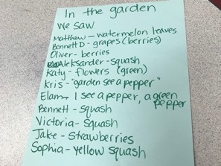
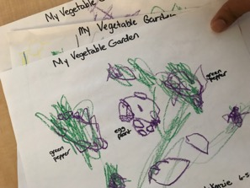
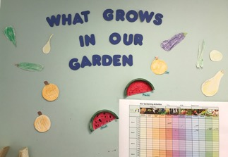
Weekly Research Assistant visits documented garden activities.
Teachers kept record of their activities in the monthly calendar.
Notes:
The wall calendar “Our Gardening Activities” served as a log of the gardening activities, day by day, and week by week.
Additionally, the garden research assistant kept a record of the activities noted in the Wall chart and the classroom.

Slide 11
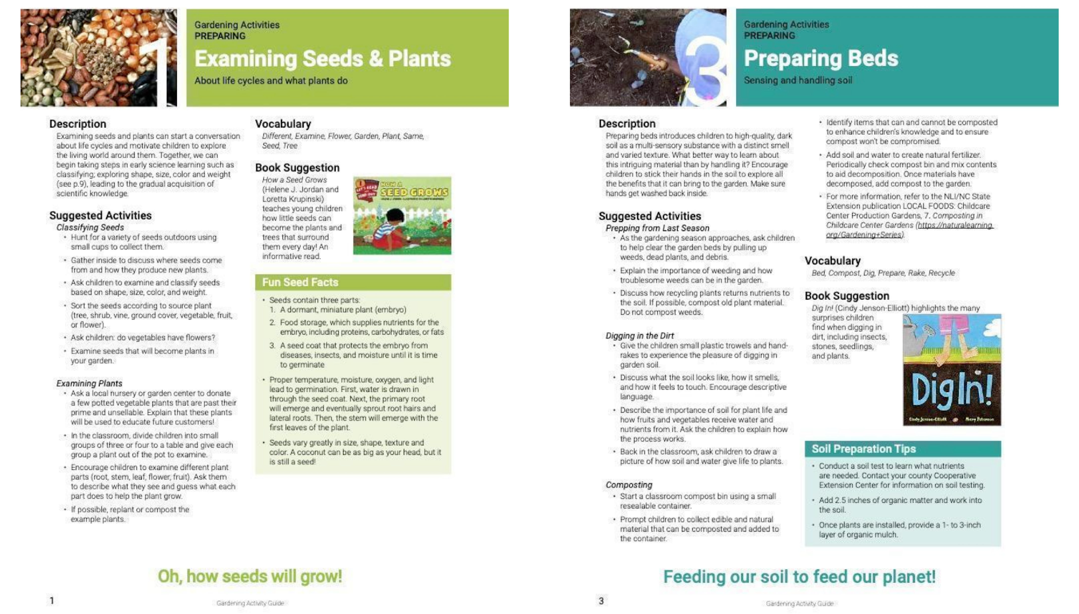
The Intervention: Two Examples of Activities
Notes:
Examples of activity pages from the Garden Activity Guide.
The activity pages include the following:
Description of the activity
Vocabulary
Suggested activities
Fun facts
Book suggestions

Slide 12
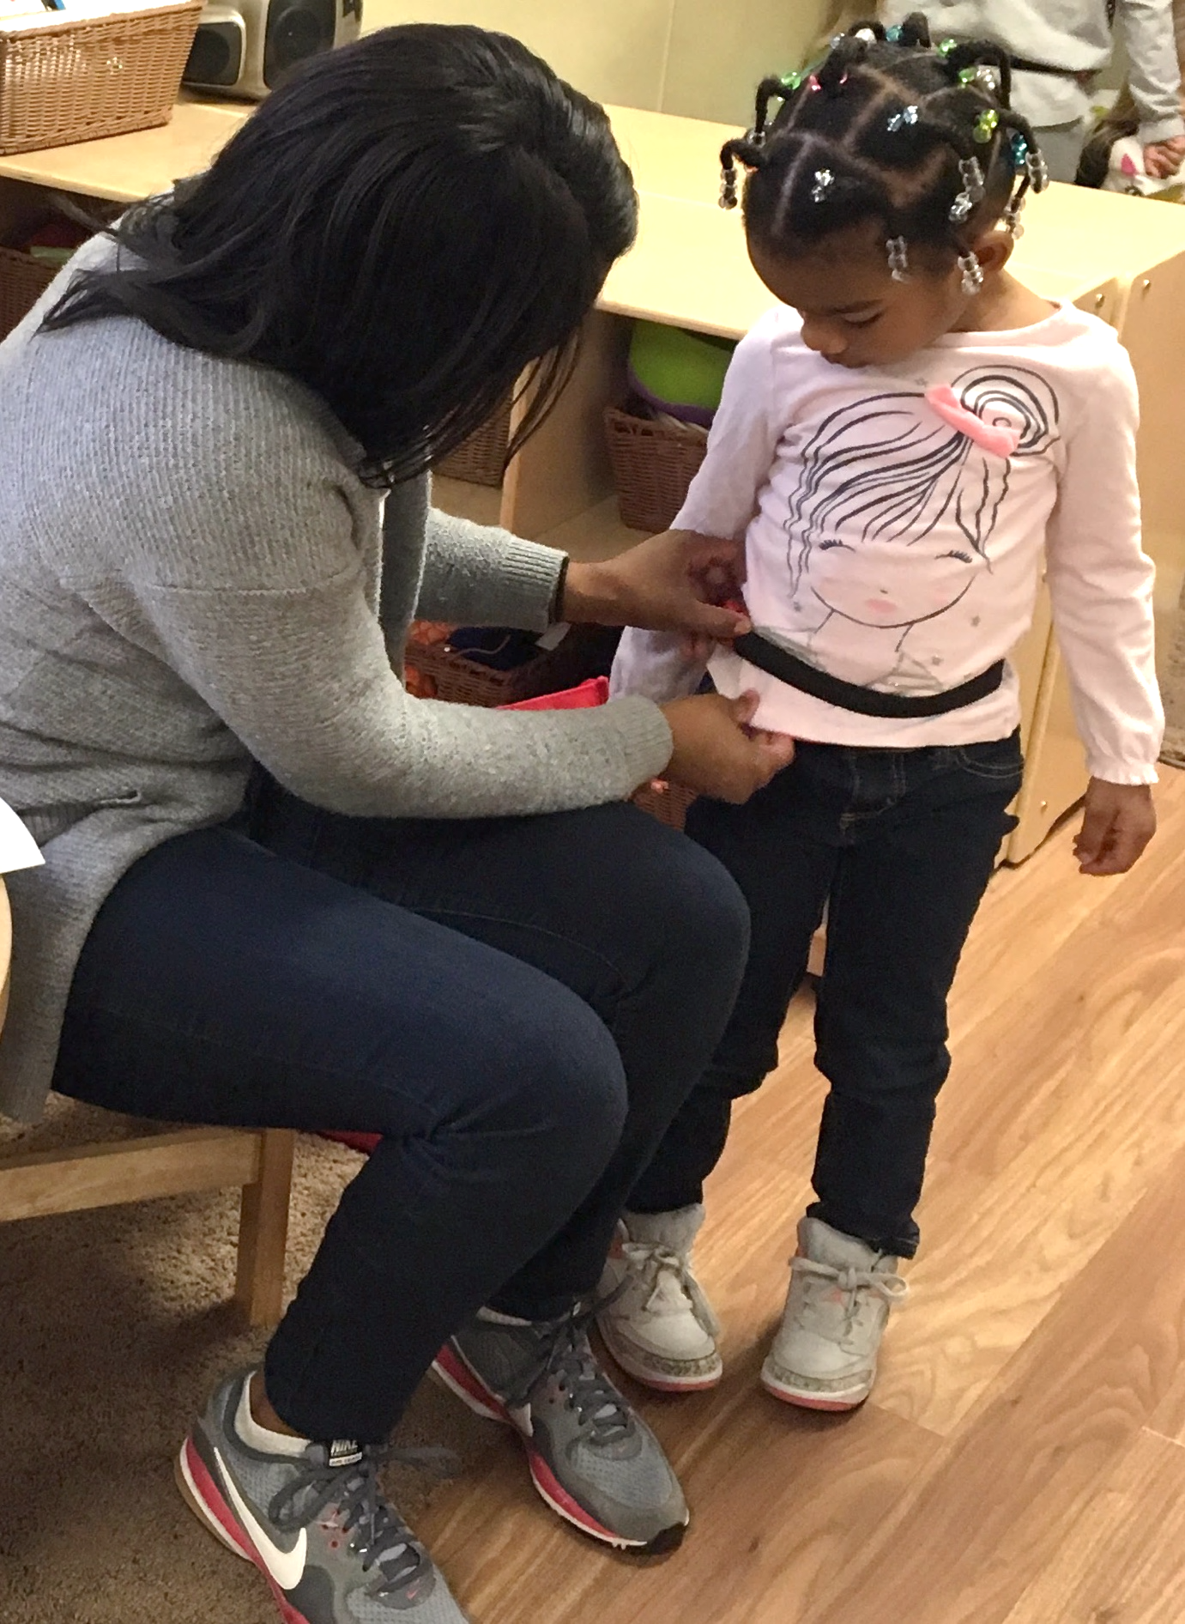
Physical Activity
Actigraph GT3X_ Accelerometers
Attached at waist with nylon belt
Worn during the day, at childcare center
Measured
Moderate to Vigorous Physical Activity (MVPA): minutes per day
Sedentary time: minutes per day
Notes:
Explain how physical activity was measured. Actigraph GT3X_ Accelerometers were used. They were attached at waist with nylon belt and worn during the day at the childcare center. These allowed us to know the Moderate to Vigorous Physical Activity (MVPA): minutes per day and the Sedentary time: minutes per day.

Slide 13
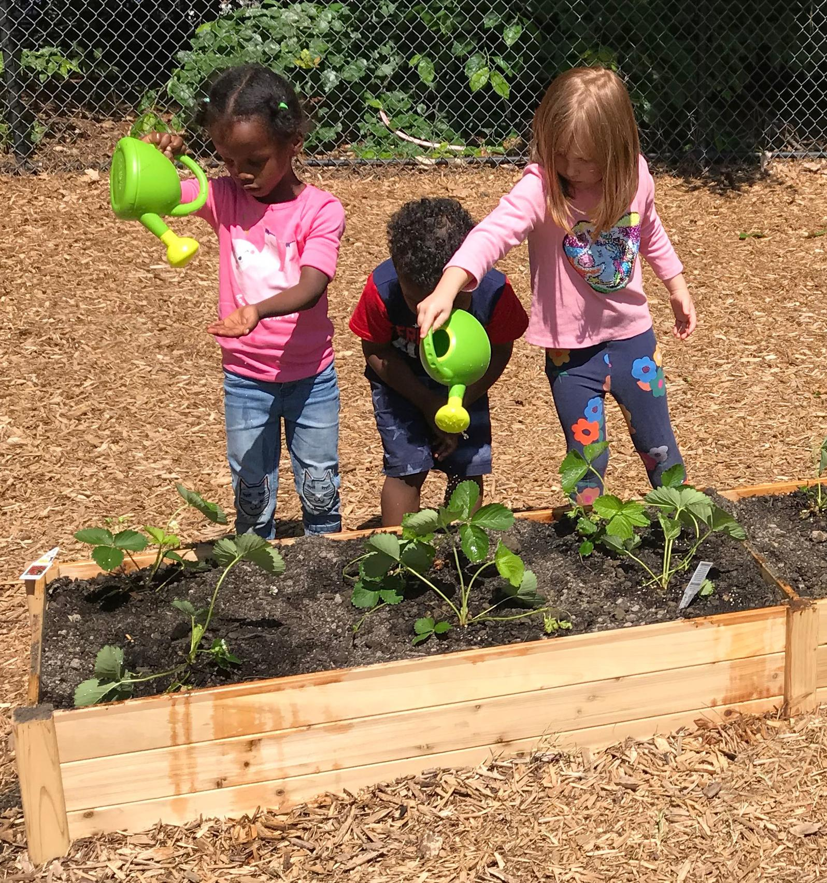
Physical Activity - Results
1) Does the garden intervention affect children’s Moderate to Vigorous Physical Activity?
Yes. Physical activity increased
Intervention effects were statistically significant MVPA [controlling for accelerometry wear time, number days with no outside time (0-2), number of days with rain (0-2) and cohort (year 1 or 2)].
2) Does the garden intervention affect children’s sedentary behavior?
Yes. Sedentary time decreased
Intervention effects were statistically significant and in the expected direction for sedentary behavior.
Notes:
Our data answered of whether the garden intervention affected children’s Moderate to Vigorous Physical Activity? Yes, it did. Physical activity increased. Intervention effects were statistically significant for MVPA [controlling for accelerometry wear time, number days with no outside time (0-2), number of days with rain (0-2) and cohort (year 1 or 2).
Our data also told us if the garden affected children’s sedentary behavior. Yes, it did. Sedentary time decreased. Intervention effects were statistically significant and in the expected direction for sedentary behavior.

Slide 14
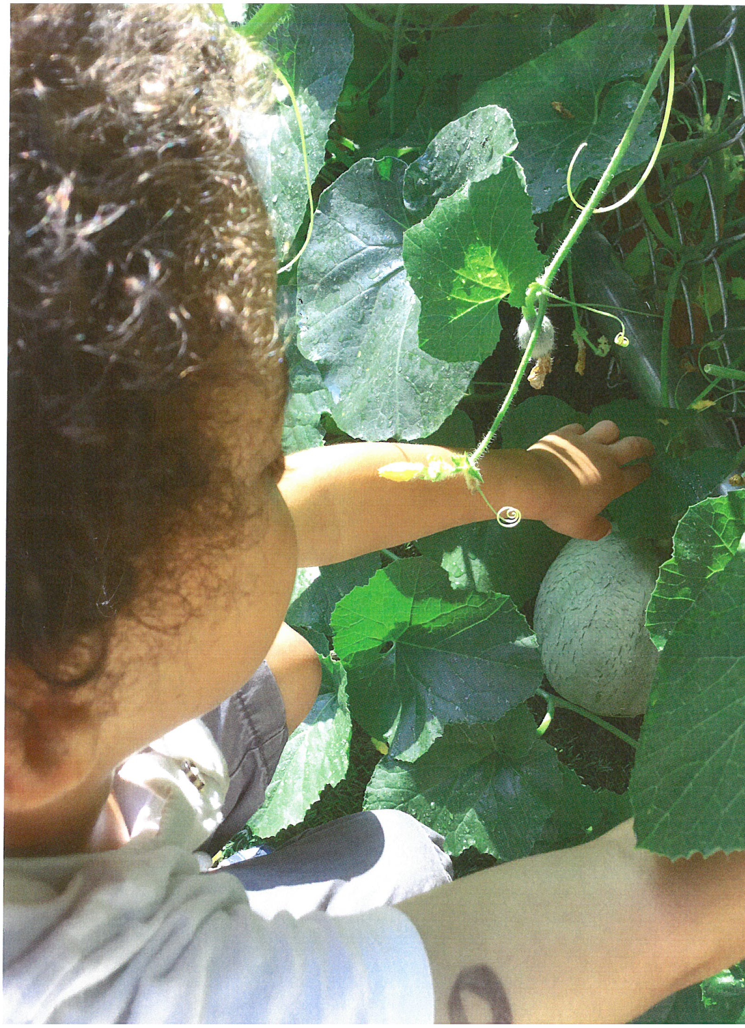
The intervention group achieved…
6 more minutes MVPA
14 minutes less sedentary time
compared to the control group
Notes:
The intervention group achieved 6 more minutes MVPA/day and 14 minutes less sedentary time/day, compared to the control group.

Slide 15
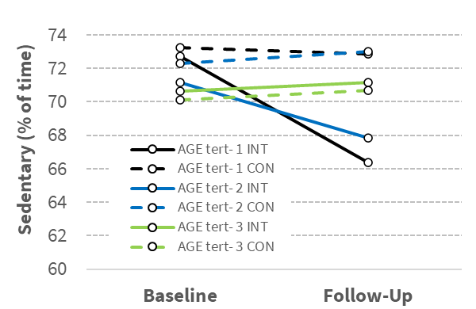
Physical Activity – Results
3b) Does age moderate the effect of the garden on MVPA? On sedentary time?
Youngest
Oldest
Middle
Middle
Youngest
Oldest
Effects of garden on MVPA stronger for youngest children.
Effects of garden on sedentary time stronger for youngest children.
Notes:
Describe graphs and results.

Slide 16
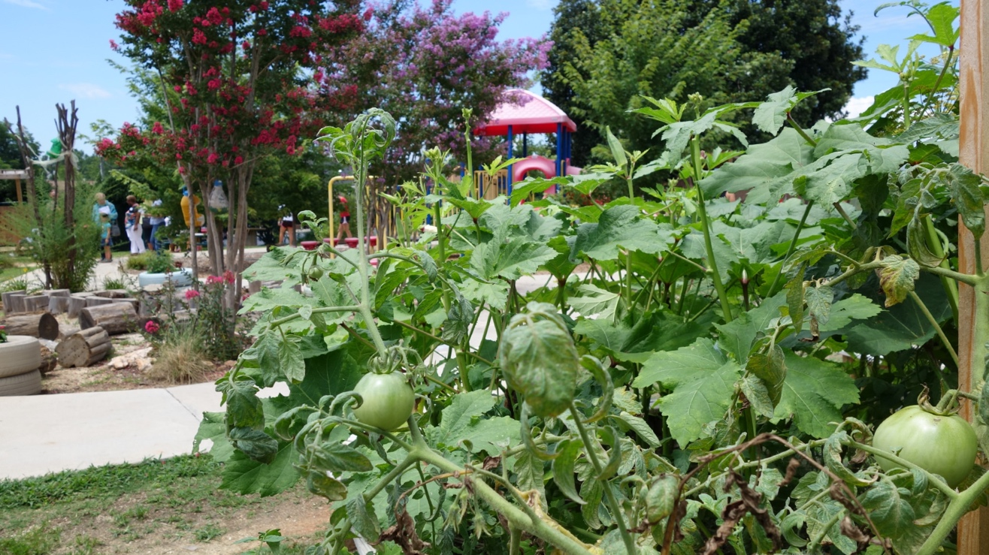
Physical Activity Conclusions
1) Does the garden intervention affect children’s Moderate to Vigorous Physical Activity? Yes.
2) Does the garden intervention affect children’s sedentary behavior? Yes.
Consistent with prior research, garden intervention increased children’s MVPA + reduced sedentary behavior.
Our findings were consistent with prior findings to early childhood and to the under-studied childcare context.
3) Does age moderate the effect of garden on Moderate to Vigorous Physical Activity? Yes.
And on sedentary behavior? Yes.
Consistent with prior research and popular knowledge “the earlier the better.”
Effects of the intervention were greater for the youngest children.
Notes:
Conclusions described. Does the garden intervention affect children’s Moderate to Vigorous Physical Activity? Yes. Did the garden intervention affect children’s sedentary behavior? Yes, and this is consistent with prior research; garden intervention increased children’s MVPA and reduced sedentary behavior. Our findings extend prior findings to early childhood and to the under-studied childcare context. Does age moderate the effect of garden on Moderate to Vigorous Physical Activity? Yes, it does. And on sedentary behavior? Yes. Consistent with prior research and popular knowledge “the earlier the better.” Effects of the intervention were greater for the youngest children.

Slide 17
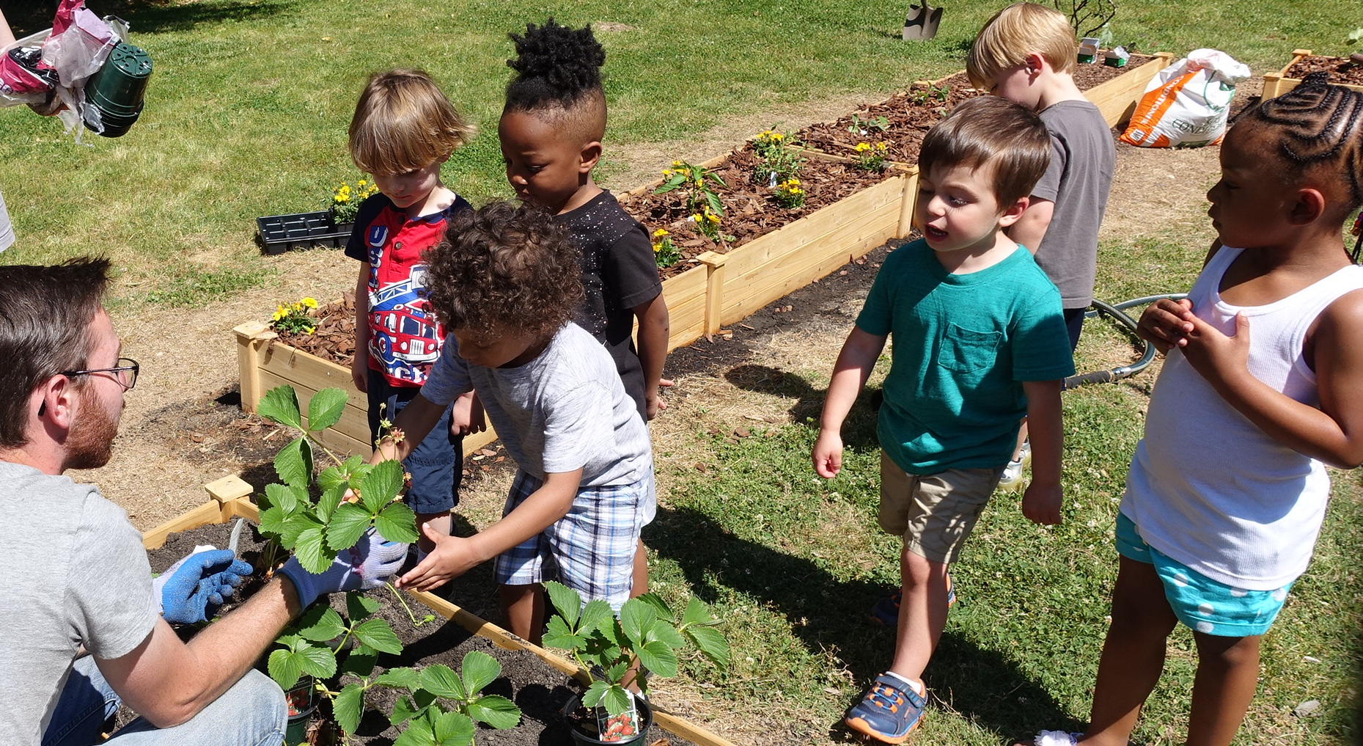
Fruit & Vegetable Identification, Liking and Consumption in Tasting Sessions - Results
Notes:
Moving to the results we gathered in our experiment (This is a Title page transitioning to the results of the Randomized Controlled Trial).

Slide 18
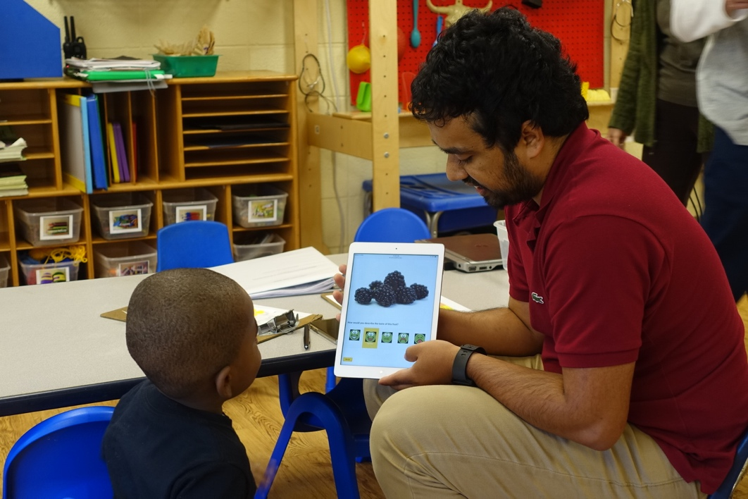
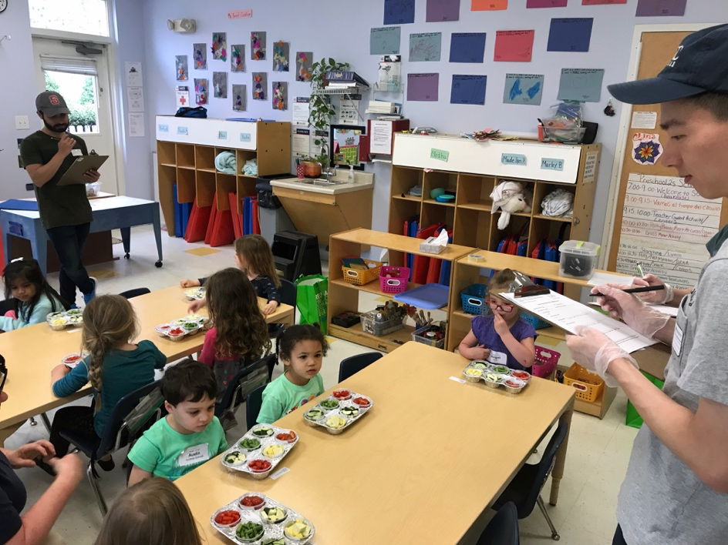
Fruit & Vegetable Identification, Liking and Consumption in Tasting Sessions - Measurements
Identification and Liking Survey
Modified “Super yummy / Super yucky” - Electronic recording system
FV Consumption Tasting Session Snack Tool
Notes:
COLEAFS measures included:
- Activity at snack time for identification of fruit and vegetables using an I-Pad.
- Tasting session at snack time.

Slide 19
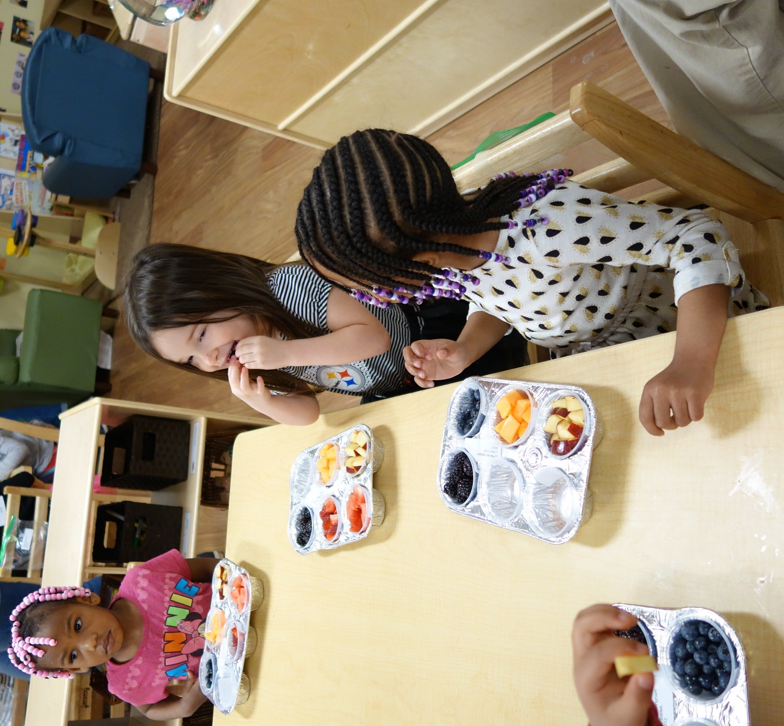
Fruit & Vegetable Identification, Liking and Consumption in Tasting Sessions - Results
1) Does the garden intervention affect children’s FV identification? Yes.
Intervention effects were statistically significant and in the expected direction.
2) Does the garden intervention affect FV liking? No.
*Intervention effects were not statistically significant (ns).
3) Does the garden intervention affect FV consumption in tasting sessions? Yes.
Intervention effects were statistically significant.
Children who received the garden intervention are expected to:
Eat more fruit (~25 grams) and more vegetables (~14 grams) during snack time (~ 39 grams more FV combined).
Notes:
Research question and findings:
First question, did the garden intervention impact children's FV identification?
Yes, intervention effects were statistically significant and in the expected direction.
Second did the garden impact if children like FV?
In this case, the intervention did not show statistical significance.
Third question was whether garden impacts FV consumption in tasting sessions?
Yes, effects were statistically significant.
The bottom line is that children who received the garden intervention (FARM to ECE proximal) are expected to eat ~25 grams more fruit and ~14 grams more vegetables during snack time
(~ 39 grams more FV combined).

Slide 20
Research >> Building the evidence >> Applying findings
Childcare Outdoor Learning Environments as Active Food Systems (COLEAFS):
Effectiveness of the Preventing Obesity by Design Gardening Component
USDA – National Institute of Food and Agriculture (NIFA) Integrated Project
5 years
Research Randomized controlled trial (RCT) research design to assess the impact of gardening on 3-5 year old children’s physical activity, FV liking, knowledge, and consumption
Research translation and application
2. Education
Community College / University education modules
3. Extension
Gardening Activity Guide publication and course
Long term goal: To influence childcare gardening practices and policies (licensing regulations, accreditation standards)
Notes:
Childcare Outdoor Learning Environments as Active Food Systems (COLEAFS) was an integrated proposal (Research, Education, Extension components). The research findings are included in educational resources, InfoSheets, and courses. The long-term goal of the project is to “influence childcare gardening practices and policies (licensing regulations, accreditation standards).” All child care centers should have a fruit and vegetable garden

Slide 21
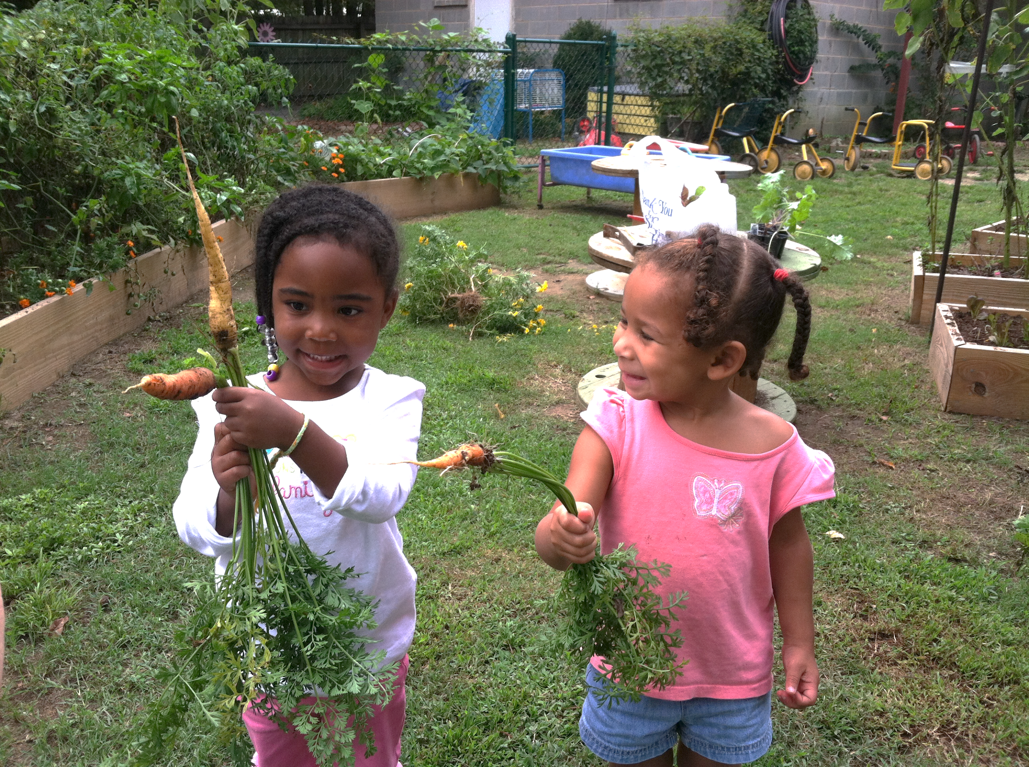
Thank you!
Nilda G. Cosco¹ ,
Nancy M. Wells² ,
Daowen Zhang¹ ,
Derek Hale³,
Muntazar Monsur ⁴,
Robin C. Moore² , and
Tong Xu² .
1 College of Design, NC State University
2. College of Human Ecology, Cornell University
3 Nutrition, Gillings School of Public Health, University of NC-Chapel Hill
4 Landscape Architecture, Texas Tech University
www.naturalearning.org
naturalearning.org/greendesk/
Notes:
Thank audience

